Slide 1

How I Manage OA Pain In Cats
Alexandre G. T. Daniel, MV, MSc, DABVP (Feline), FFABVP(CAPMP)
American Board-Certified Feline Specialist
ABVP Founding Fellow in Companion Animal Pain Management
Gattos Medicina Felina®
CatExpert®

Slide 2
X | No, Nothing to disclose
 | Yes, please specify
Alexandre G.T. Daniel, MV, MSc., DipABVP(Feline), FFABVP(CAPM)
FINAL DISCLOSURE:
Consulting Engagement: Elanco, Avert/Biolab, Zoetis, VIN, Hill’s Cat Advisory Team
Speaker: Elanco, Avert/Biolab, Zoetis, Royal Canin
Committee member: ISCAID, FelineVMA
UNLABELED/UNAPPROVED USES DISCLOSURE:
Some drugs mentioned here are not approved for use in cats in some countries/regions

Slide 3
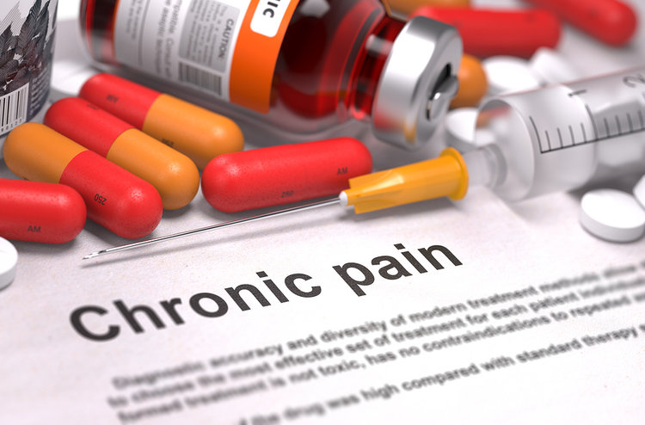
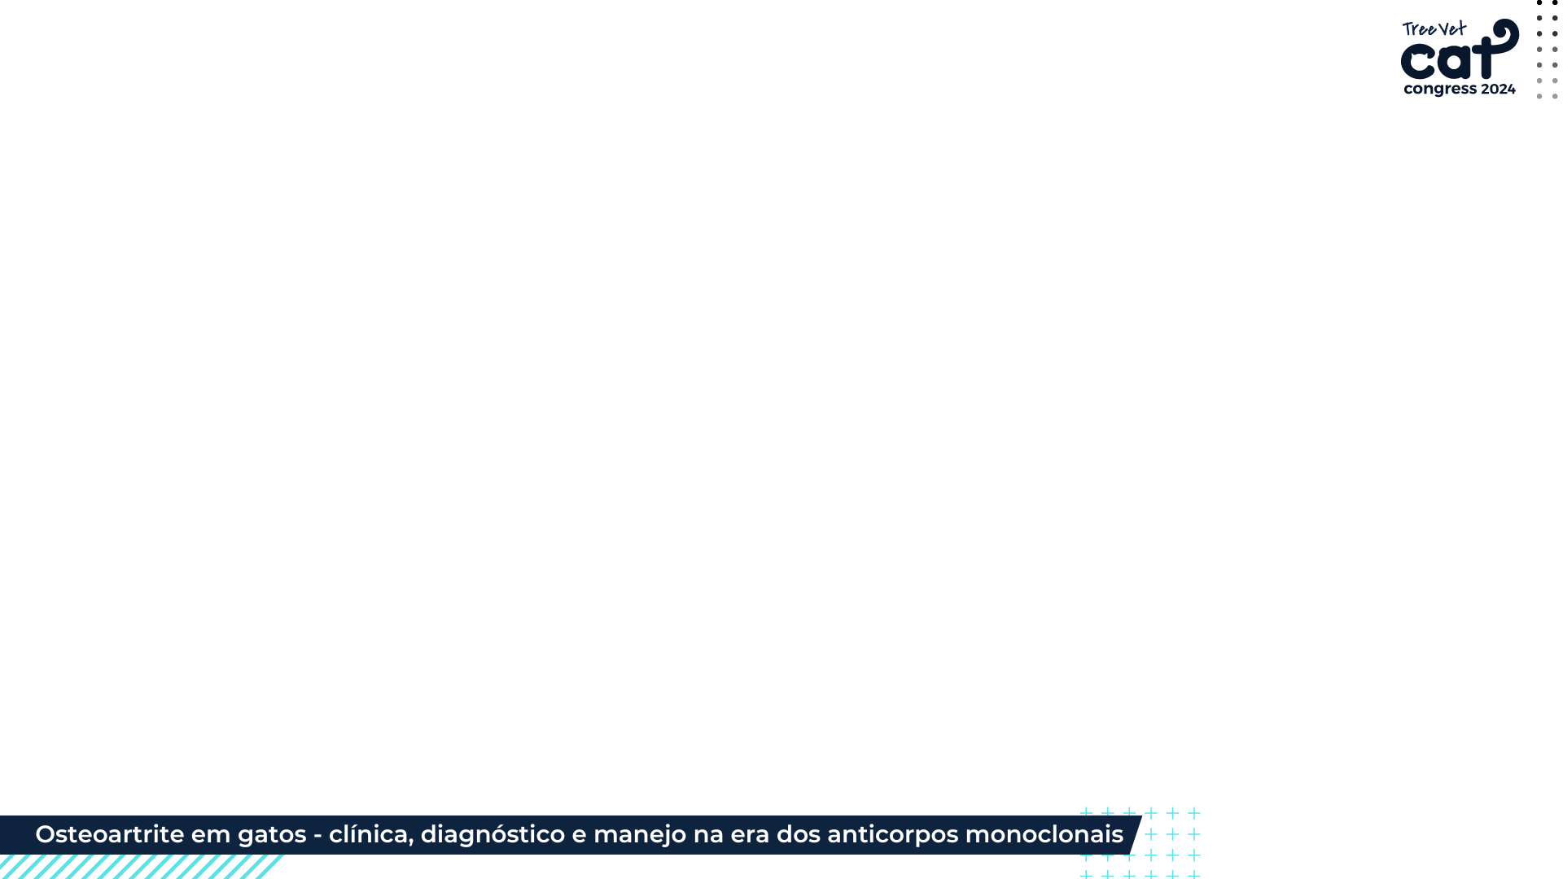

Slide 4
Clinical signs
Different from dogs!
Primarily mobility and behavioral changes.
Tend to compensate for orthopedic alterations (abnormalities or problems) through adaptive mobility strategies
Constipation and inappropriate elimination
Alopecia and self-trauma over affected joints
Reduced self-grooming behavior
Altered sleep quality
Changes in mood or temperament

Slide 6
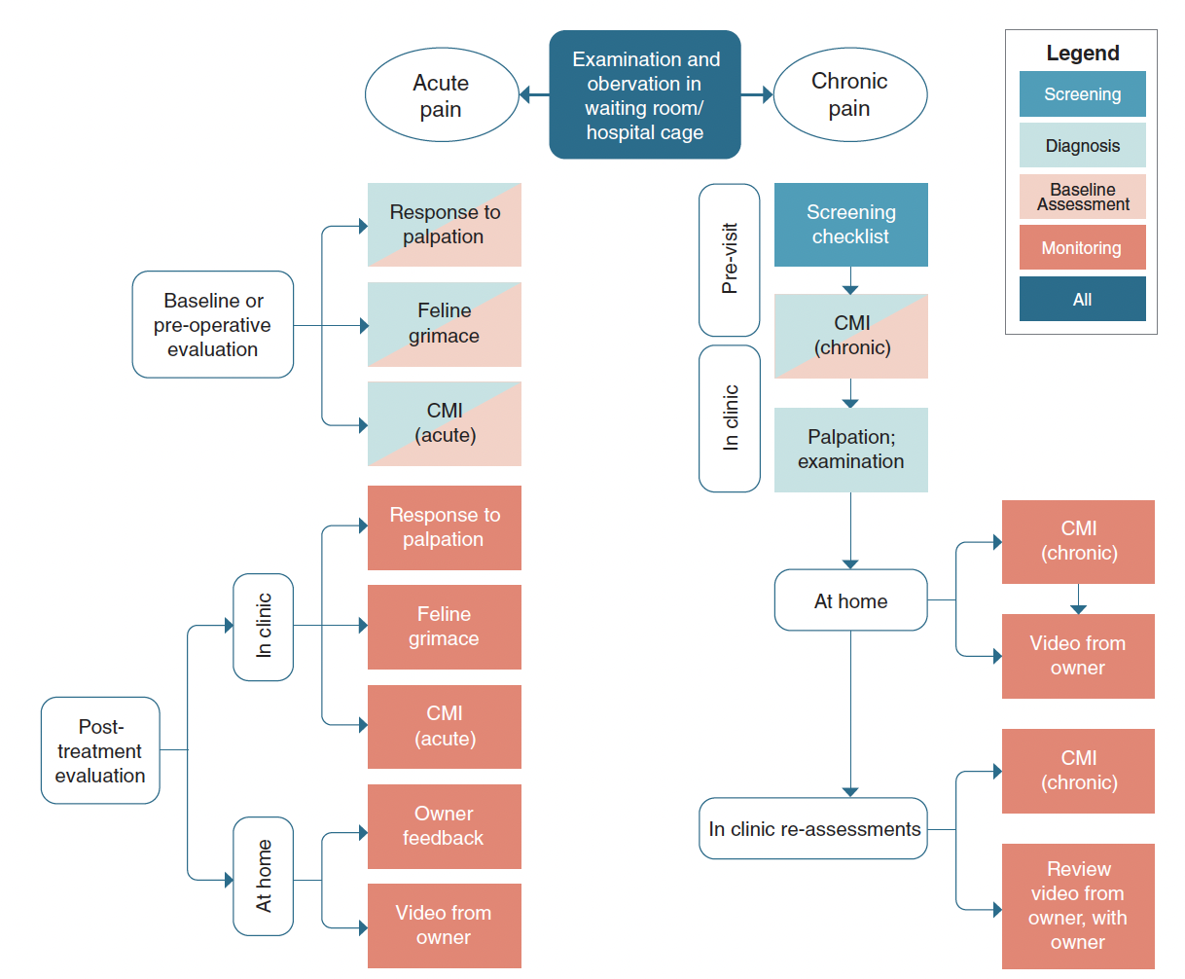
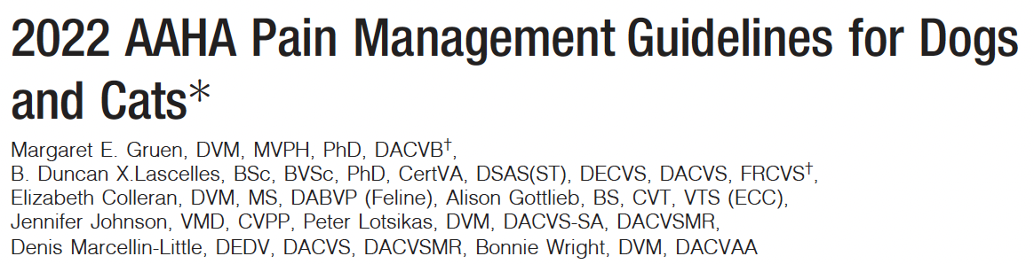
Diagnosis
Screening checklist
CLINICAL MEASUREMENT INSTRUMENTS

Slide 7
*Percentage of DJD and non-DJD cats scored as impaired by their caregivers
Notes:
Please note that this slide shows the original graph for the paper Development of a checklist for the detection of degenerative joint disease-associated pain in cats, and highlights the most common behaviors associated with OA pain.
Percentage of degenerative joint disease (DJD) and non-DJD cats scored as impaired by their owners for each question by the DJD non-informed cohort of owners.
VAS= visual analog scale.

Slide 8
Feline Musculoskeletal Pain Index short form (FMPIsf)
Enomoto M, Lascelles BDX, Robertson JB, Gruen ME. Refinement of the Feline Musculoskeletal Pain Index (FMPI) and development of the short-form FMPI. 2022 Feb;24(2):142-151. doi: 10.1177/1098612X211011984. Epub 2021 May 18.

Slide 9
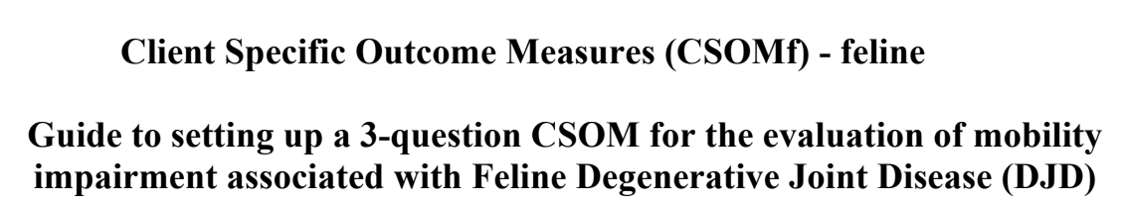
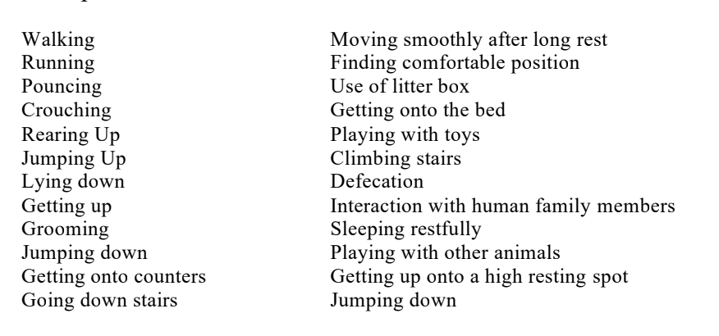
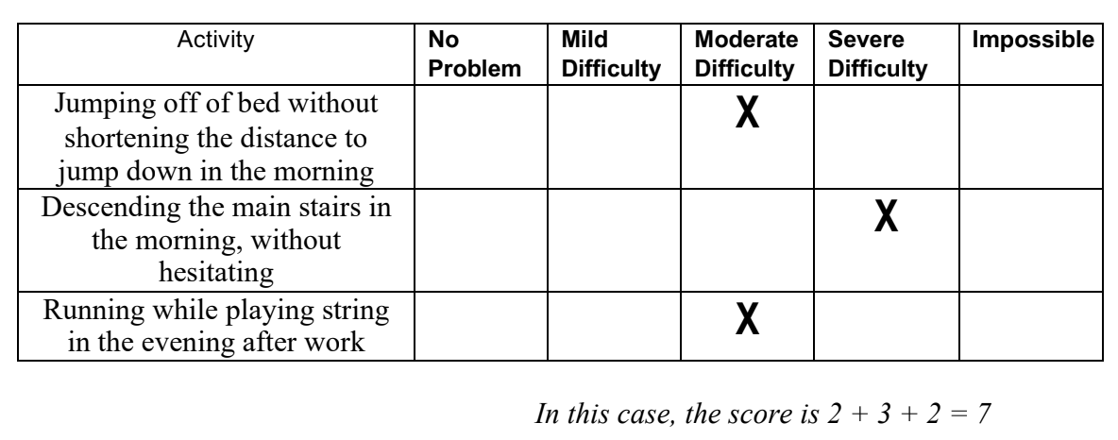
https://cvm.ncsu.edu/research/labs/clinical-sciences/comparative-pain-research/clinical-metrology-instruments/
Lascelles BDX, Hansen BD, Roe S, Depuy V, Thomson A, Pierce CC, et al. Evaluation of client-specific outcome measures and activity monitoring to measure pain relief in cats with osteoarthritis. Journal of Veterinary Internal Medicine. 2007;21(3):410-6.

Slide 10
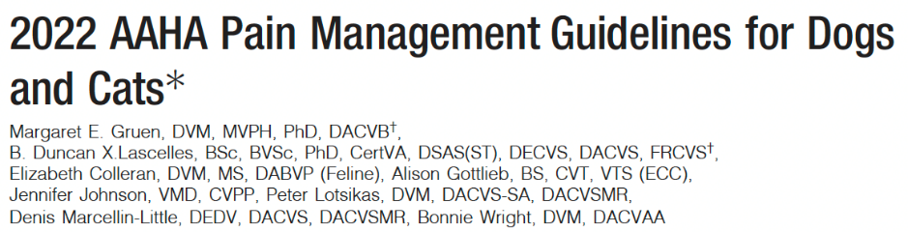
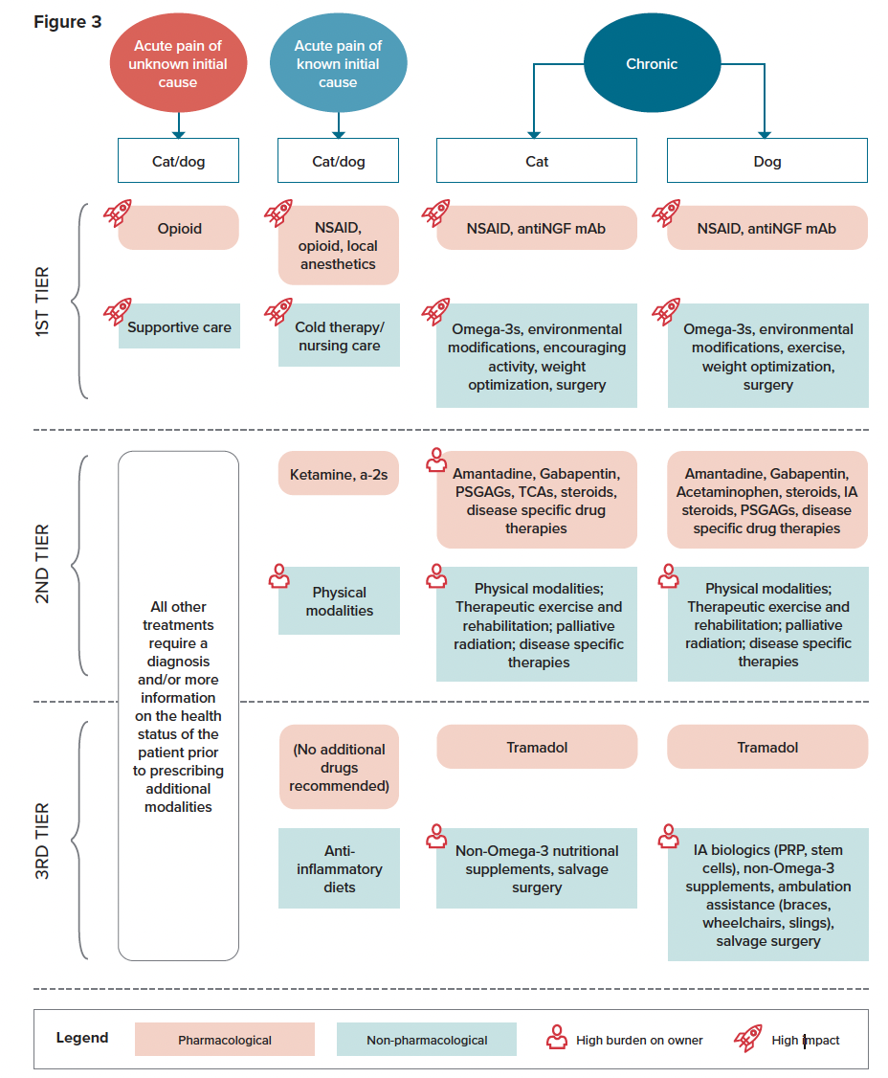
MULTIMODAL
Notes:
Please note this is an image from the 2022 AAHA Pain Management Guidelines for Dogs and Cats.

Slide 11
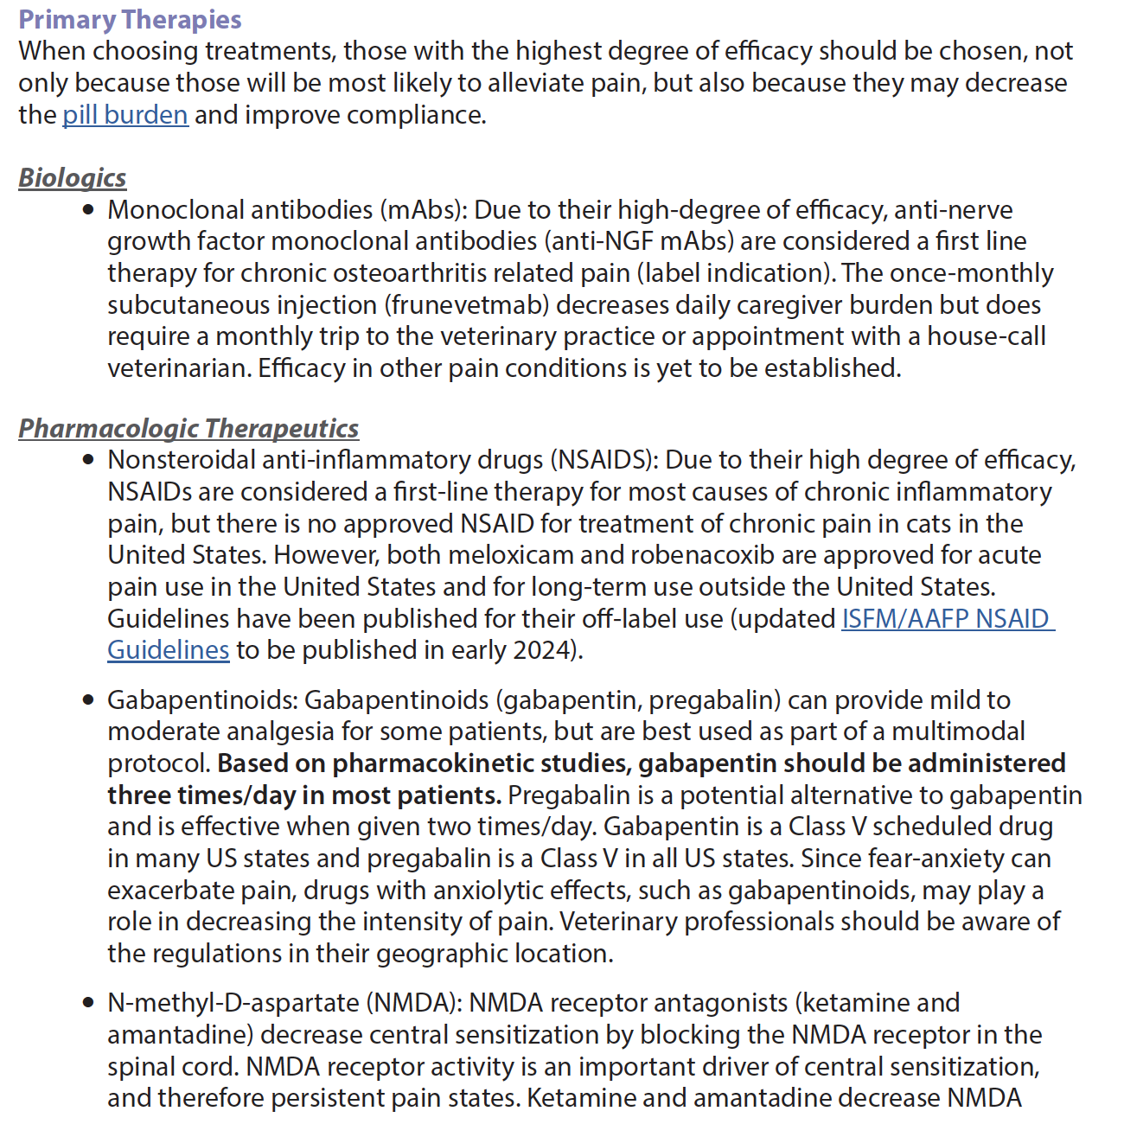

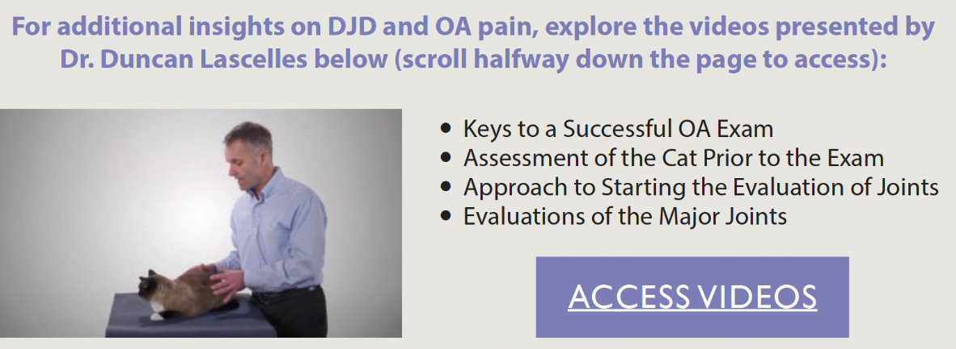

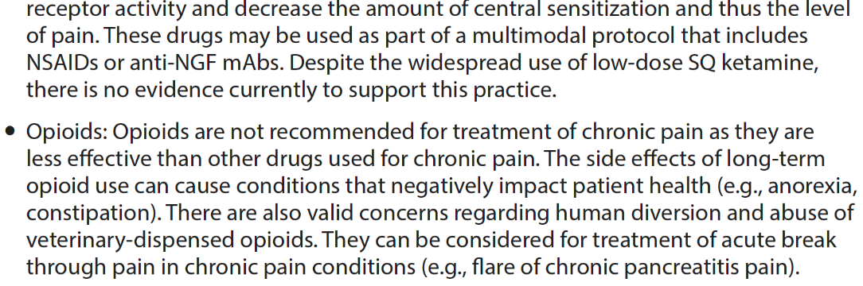
Notes:
Please note this is taken directly from the FelineVMA Chronic Pain Toolkit.

Slide 12


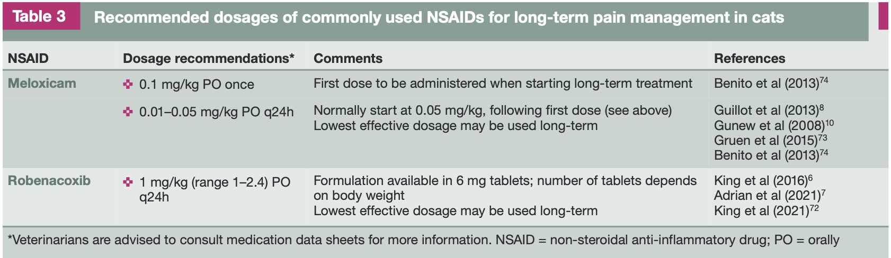

Slide 13
Anti-NGF monoclonal Ab
NGF - neurotrophin
It binds to the TrkA receptor (&p75)
Growth and maintenance of the CNS during developmental stages
In adults, NGF acts as a pro-nociceptive signaling protein in conditions where it is overexpressed

Slide 15
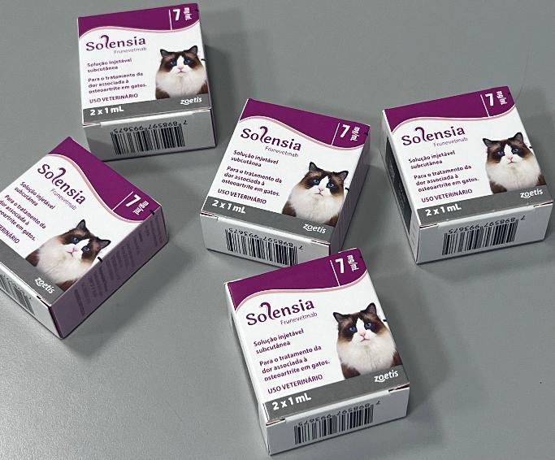
Anti-NGF monoclonal Ab
77% percent of cat caregivers reported observing an improvement in pain-related signs after their cats were treated with Solensia for three months¹*
Supports improved mobility, comfort, and overall wellbeing in cats²
In a field study involving cats with chronic kidney disease at IRIS stages 1 and 2, Solensia was found to be well tolerated in these patients^{3*}
A total of 131 out of 267 treated cats were identified as having chronic kidney disease at IRIS stages 1 or 2.
1. Gruen ME, Myers JAE, Tena JS, Becskei C, Cleaver DM, Lascelles BDX. Frunevetmab, a felinized anti-nerve growth factor monoclonal antibody, for the treatment of pain from osteoarthritis in cats. J Vet Intern Med. 2021 Nov;35(6):2752-2762;
2. Gruen ME, Myers JAE, Lascelles BDX. E cacy and Safety of an Anti-nerve Growth Factor Antibody (Frunevetmab) for the Treatment of Degenerative Joint Disease-Associated Chronic Pain in Cats: A Multisite Pilot Field Study. Front VetSci. 2021 May 28;8:610028;
3. Estudo NV-02-11F16-001

Slide 16
Gabapentinoids
Gabapentin
5-10mg/kg BID-TID
Pregabalin
1-4mg/kg BID

Slide 18
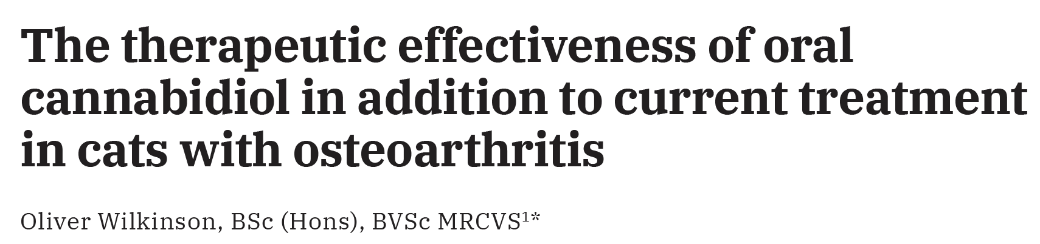
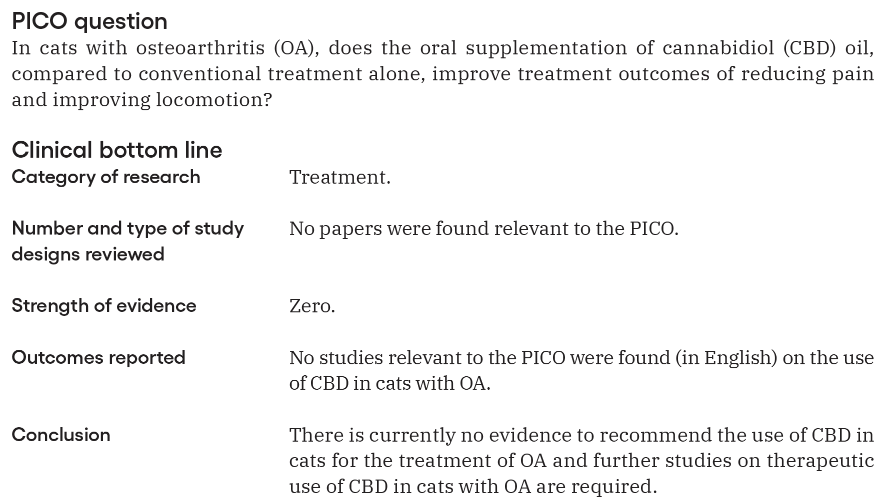

Slide 19






alexandre.daniel@gattos.vet.br
www.catexpert.com.br
www.gattos.vet.br
Gattos Medicina Felina
CatExpert
@gattosmedicinafelina
@catexpert_cursos

