Slide 1


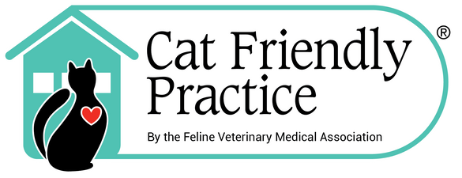
Cat Friendly Practice®
2025 Survey Results
Here are the highlights and key findings from the 2025 survey, including feedback and suggestions from your colleagues. The complete results are shared with FelineVMA leadership, the Cat Friendly Practice® Committee, and thoroughly reviewed by the Headquarters Staff. Thank you to those of you who responded!
www.catvets.com/cfp

Slide 2

www.catvets.com/cfp
Notes:
We are thrilled to report that over 99% of CFPs continue to be satisfied and 97% would
recommend the Cat Friendly Practice® Program.
Here are some other highlights of the year’s survey :
92% of CFPs reported their practice staff have improved knowledge and feline care
which matches the results since 2023.
84% received positive feedback from clients on being a CFP.
87% stated positive team dynamic impact when handling, treating, and caring for cats.
We encourage you to share the infographic above with your team members to demonstrate
the value of the Cat Friendly Practice® Program.

Slide 3

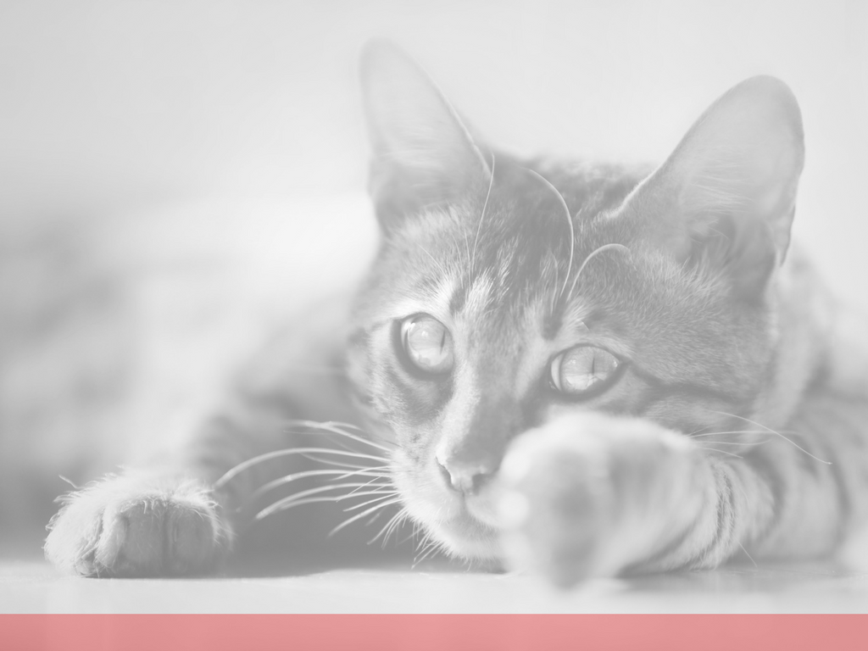

Cat Friendly Practice® Survey Results
Why would you recommend the Cat Friendly Practice® Program – Top Responses
Better care for feline clients (74 responses) 6. Improved safety (16 responses)
Educational Resources (58 responses) 7. Easier visits/positive experience (39 responses)
Best practice/medicine (41 responses)
Less stress for cats and clients (37 responses)
Shows your care (51 responses)
www.catvets.com/cfp
Notes:
Would you recommend the Cat Friendly Practice® Program to other
veterinary professionals?
(211 responses)
Yes - 97+% (205 responses)
No - 3% (6 responses)
Why would you recommend the Cat Friendly Practice® Program
(202 responses)
We compiled the top responses into these seven main areas:
Better care for cats/feline clients
Educational and training resources available as part of the Cat Friendly Practice Program
Best practices/best medicine
Less stress for cats and clients
Shows you care/Builds trust with clients
Improved safety for staff and cats
Easier veterinary visits and a more positive experience for cats and clients
Few quotes from survey respondents:
It is of utmost importance to provide the best and least stressful care to all our feline
patients. It is important for all colleagues to understand that the happier our patients
are, the happier the clients are and it makes our jobs easier and more pleasurable.
We feel that not only did it help embrace better care of our feline clients but also
added value to our clinic.
Builds trust with clientele; it's just good medicine.
Love the educational social media content. Good tools for those for whom being
"cat friendly" doesn't come naturally (due to previous miseducation or other). Good
resources to be able to explain to clients why we do what we do.
It helps to understand cats more and their behavior and tailor medical care, handling,
transporting, and enables things to go smoother when your patient is not as stressed
get more done more productive and happier cat.
It is a great way to train your staff to provide optimum care, safely.
By reducing cats stress at the clinic with easy modifications, it makes it a safer environment
for staff. It increases client’s satisfaction with the care we provide. Overall, it increases the
cats care and health by increasing not only more regular check ups but also a more thorough
exam as the cat has more “kitty minutes” available.

Slide 4
Cat Friendly Practice® Survey Results
www.catvets.com/cfp
Notes:
Which benefits do you believe your practice has experienced because you are a Cat Friendly Practice®?
(Choose up to THREE benefits – those you consider most meaningful. (203 responses)
Top benefits:
Less stress on feline patients - 83% (169 responses)
Increased staff awareness on understanding how to interact and handle cats (e.g., interpreting fear and distress) – 76% (155 responses)
Higher satisfaction among current clients with cats - 40% (82 responses)
Demonstrates how much we care about our patients – 28% (57 responses)
Gained new feline patients - 19% (38 responses)
We are the practice of choice for cat clients among other practices in the area – 18% (37 responses)
Improved retention or more frequent visits from existing cat clients - 17% (34 responses)

Slide 5
Cat Friendly Practice® Survey Results
www.catvets.com/cfp
Notes:
Have you seen an improvement in feline knowledge and care among
your staff since implementing the Cat Friendly Practice® Program
at your practice? (208 responses)
Yes - 88% (183 responses)
No - 4% (8 responses)
Unsure – 8% (17 responses)

Slide 6

Cat Friendly Practice® Survey Results
www.catvets.com/cfp
Notes:
Has there been a positive change in your team dynamic in regards to the
treatment and care of cats including Cat Friendly interactions and
handling due to the Cat Friendly Practice® Program? (e.g., higher
satisfaction when dealing with feline patients or increased sense of team collaboration
or morale)
Yes - 88+% (183 responses)
No - 4+% (9 responses)
Unsure - 7+% (15 responses)
We’ve asked this question since 2017 and survey respondents state there has been
a positive change in team dynamic. The lowest percentage of ‘Yes’ responses was
in 2020 with 80% and this highest was in 2021 with 94%.

Slide 7
Cat Friendly Practice® Survey Results
www.catvets.com/cfp
Notes:
This was a new question and the results are interesting!
In the past three years, have you seen any changes to the way cat caregivers
want, need, and expect care for their cats? Please select all that apply.
(203 responses)
More informed and proactive caregivers - 63% (127 responses)
Higher demand for creating a positive veterinary experience for
cats - 36% (124 responses)
Increased willingness to invest their time and finances to their cat’s
care - 56% (114 responses)
Stronger perception of cats as family members (leading to higher emotional investment) - 56% (114 responses)
Greater expectation for immediate results (e.g., faster diagnostics, same-day answers) – 36% (74 responses)
Higher demand for advanced or specialized care (e.g., referral services, cutting-edge treatments) – 36% (74 responses)
More emphasis on preventive care and wellness - 28% (57 responses)
Greater focus on convenience and accessibility (e.g., telemedicine, flexible scheduling) – 13% (26 responses)
No significant change observed – 6% (12 responses)

Slide 8
Cat Friendly Practice® Survey Results
www.catvets.com/cfp
Notes:
Another new question in this year’s survey.
Which of these do you or team members do? Please select all that apply.
Providing towels/blankets for a cat to hide - 97% (195 responses)
Providing a soft surface on the exam table - 90% (182 responses)
Giving fearful-anxious cat breaks during the examination - 89% (179 responses)
Allowing cats to acclimate to the examination room - 87% (176 responses)
Providing tips to caregivers before the visit about carrier choice and acclimation, reducing fear-anxiety, and/or covering the carrier with a towel/blanket - 87% (175 responses)
Recording what the cat prefers in their file (e.g., petting location, treats, tips on what made the visit easier) - 86% (174 responses)
Calling a cat "spicy" - 49% (98 responses)
Having photos/pictures hanging or displaying in your practice of a cat's face or body - 38% (77 responses)
Labeling a cat in their file with terms like fractious, spicy, sassy, aggressive, a bad actor, a grouch, etc. - 24% (49 responses)
Calling a cat "fractious" - 20% (40 responses)
Calling a cat "sassy" - 17% (35 responses)
Describing a cat as " aggressive" - 11% (23 responses)
Calling a cat other terms such as a " sourpuss," " grouch," "mean," etc. - 2+% (5 responses)
Calling a cat "bad actor" - 2% (4 responses)
None of these apply - .5% (1 response)

Slide 9
Cat Friendly Practice® Survey Results
www.catvets.com/cfp
Notes:
These two questions correspond with each other.
Overall, how does your 2025 revenue compare to 2024?
Overall revenues have increased - 56+% (114 responses)
Overall revenues stayed the same - 32+% (65 responses)
Overall revenues decreased - 11+% (23 responses)
Do you believe any of the increase can be attributed to being a Cat Friendly Practice?
Yes, but not sure of how much - 39% (45 responses)
Yes, some of the increase - 29% (33 responses)
No, it is not due to being a Cat Friendly Practice - 20% (23 responses)
Yes, most of the increase - 11% (13 responses)

Slide 10
Cat Friendly Practice® Survey Results
www.catvets.com/cfp
Notes:
How has the feedback from your cat clients been about your status as a Cat Friendly Practice®?
(202 responses)
The feedback has been extremely positive – 28+% (57 responses)
The feedback has been very positive – 43+% (87 responses)
None of them have noticed or commented – 15+% (31 responses)
The feedback has been somewhat positive – 13+% (27 responses)

Slide 11
Cat Friendly Practice® Survey Results
Are there "unique" Cat Friendly changes, procedures, or enhancements that were made to your practice or the feline visit experience? Could you elaborate as we are looking to share unique ideas that practices have implemented? (114 responses)
Unique responses:
We have a feline technician who does the feline only tech appointments, handles the feline specific phone calls with clients.
Teaching cat caregivers how to give Churu with a dose syringe to help with potential medication administration in the future.
We added glass caging with multiple lighting options and a frosted lower glass covering to increase privacy.
Hidey hole in each exam room that can be easily opened to examine cats.
We are doing more house calls for cats.
A cat relief area where cats can be released while waiting.
We added feline friendly plants to the room.
Removed pictures of cat’s faces/bodies in the practice as they upset some patients.
www.catvets.com/cfp

Slide 12
Cat Friendly Practice® Survey Results
Are there "unique" Cat Friendly changes, procedures, or enhancements that were made to your practice or the feline visit experience? Could you elaborate as we are looking to share unique ideas that practices have implemented? (114 responses)
Unique responses:
We have tunnels in our cat rooms that are cubes that can be sterilized and moved apart. We sometimes do an entire exam in the cube.
Protective emotions is now vocabulary we use.
We added a sound machine to our cat room to help dampen clinic noise and added kennel pop-up tents for patients to hide in.
We use small needles as much as possible, go slow and quietly, and tell the cat what we are doing during each of the steps to help them tolerate procedures. I think gently talking them through the process of an exam and procedures helps the patient to feel like we are taking their feelings into account.
One thing we are instituting for 2026 is that we will have a toy chest in our cat exam room and cat waiting area. Once a feline patient has completed their appointment, we will let them pick a toy.
www.catvets.com/cfp

Slide 13
Cat Friendly Practice® Survey Results
Are there "unique" Cat Friendly changes, procedures, or enhancements that were made to your practice or the feline visit experience? Could you elaborate as we are looking to share unique ideas that practices have implemented? (114 responses)
Unique responses:
We have smart TVs in the exam rooms that play cat tv with birds, squirrels, and rabbits. We also have fish tanks in each exam room facing the exam tables.
A separate heater in the cat housing area - sliding glass door closes this off so cats can get warm but we can see in and they can see out.
If a cat is shy, I will put a couple of drops of my calming essential oil blend into my hand, rub my hands together, and pet down the cat’s sides for extra calming aromatherapy.
Velcro blankets
Create spaces where caregivers can spend the nights with hospitalized cats such as the pediatrics area in humans.
www.catvets.com/cfp

Slide 14
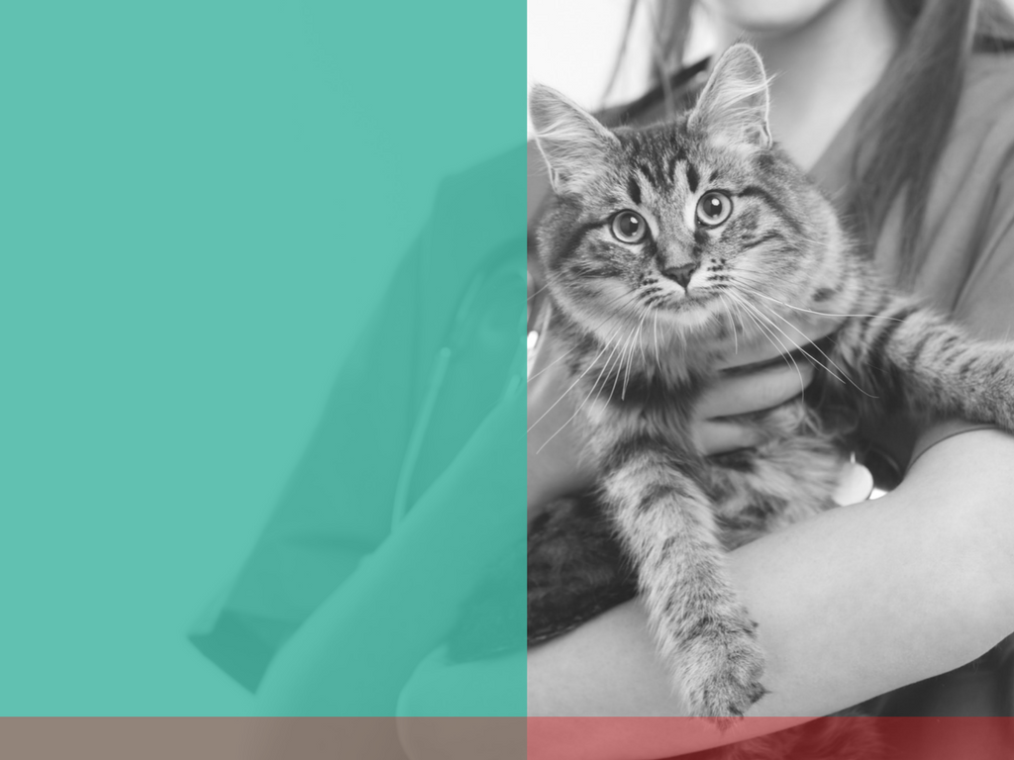
If you have any questions or comments regarding the 2025 Cat Friendly Practice® survey results, please email us at info@catvets.com.
www.catvets.com/cfp
Notes:
If you have any questions or encounter any issues, please email us at info@catvets.com or call us at 1-800-874-0498.

