Slide 1
Nursing & Nutrition for the Hospitalized Inappetent Feline Patient
Ashlie Saffire, DVM, DABVP (Feline)
President, FelineVMA

Slide 2
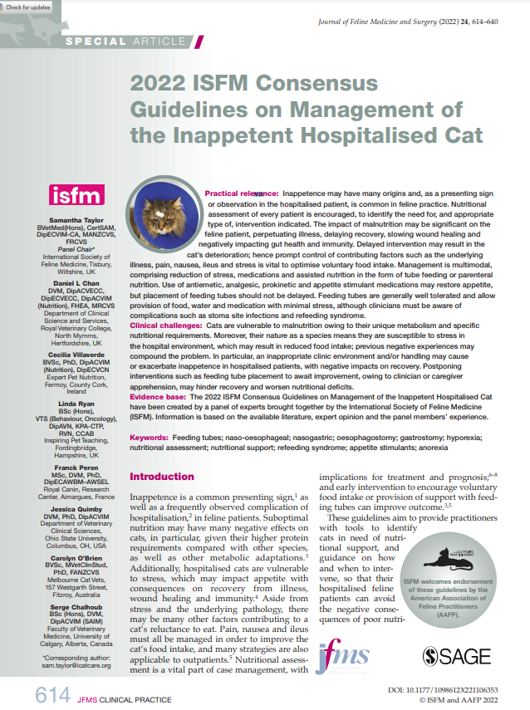
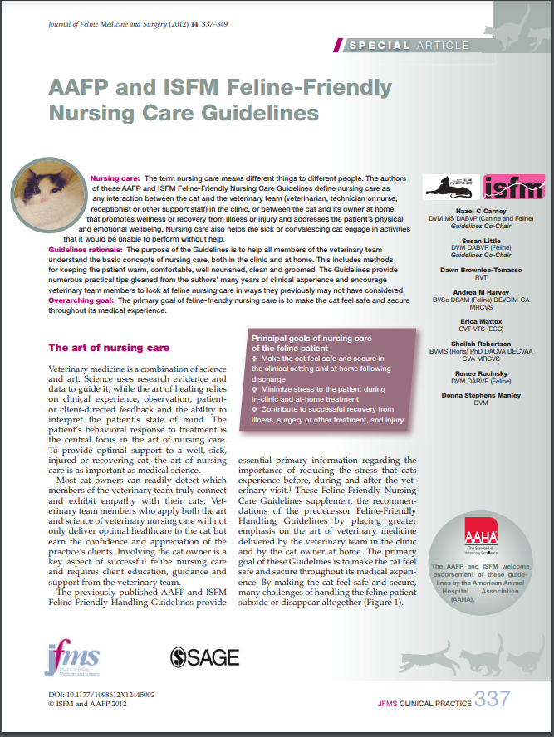
AAFP Guidelines
Saffire 2024
Notes:
Excellent resources

Slide 3
Dysrexia: a disruption/distortion of normal appetite or eating patterns
Hyporexia: reduction in appetite, not consuming full MER
Anorexia: sustained loss or lack of appetite
Key Point: Inappetence in cats is a common complication of illness and hospitalization!
Saffire 2024

Slide 4
Decreased nutritional intake (in a species with high protein requirements)
Inflammatory responses shift metabolism towards a catabolic state
Loss of lean body mass
Compromised wound healing
Suppressed immune fxn
Altered hepatic metabolism (HL)
Increased morbidity and mortality
Reduced chance of survival
During Illness/Hospitalization
Key Point: Nutritional support is an essential part of therapy for critically ill cats.
Saffire 2024
Notes:
Hyporexia and anorexia in a species with high protein requirements can quickly result in many negative effects.
Nutritional support for the critically ill is an important part of nursing hospitalized patients and prompt intervention is crucial to recovery.

Slide 5
Inability to eat (e.g., neurologic disease, injury)
GI/Pancreatic disease (e.g., nausea, vomiting, diarrhea, ileus, constipation)
Neoplasia
Respiratory/Cardiac disease (e.g., URI, CHF)
Pain/Stress
Dehydration/Electrolyte imbalances (e.g., CKD)
Medication side effects (e.g., antibiotics, antifungals, chemotherapy)
Causes of Inappetence
Saffire 2024
Notes:
Causes of inappetence in cats are numerous, and these are just some examples.

Slide 6
Where Do We Start?!
DVM’s Role
Nurse’s Role
Diagnose and address the underlying medical condition
Provide appropriate fluid resuscitation, analgesia, and anti-emetic/anti-nausea therapy
Obtain thorough diet history from caregiver
Feeding preferences (amount, how often)
Preferred textures (gravy vs pate)
Preferred flavors
Temperature preference
Offering food with unfamiliar taste and textures can contribute to inappetence and food aversion
Saffire 2024
Notes:
Before we even think about nutritional support, we need to diagnose and address the underlying medical condition because failure to address the underlying cause will result in ongoing inappetence.

Slide 7
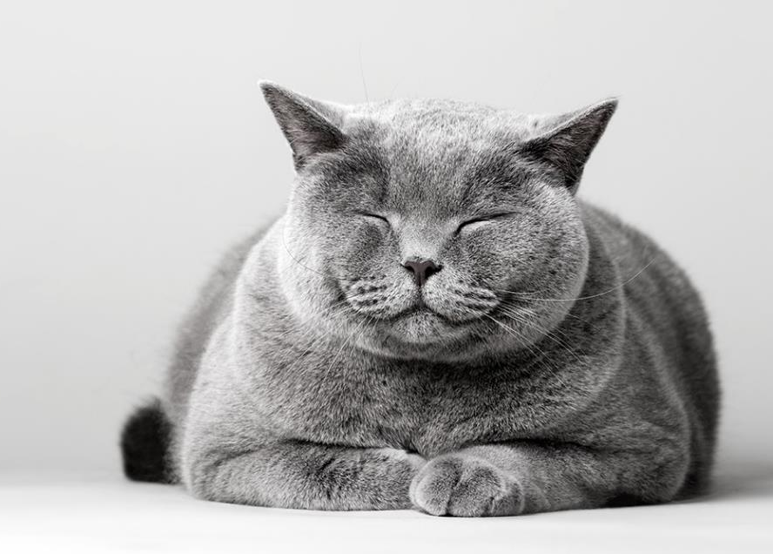
Increasing Nutritional Intake: HOW?
Optimize the clinic environment
Increase the palatability of food
Initiate the use of appetite stimulants
Provide enteral nutrition (via feeding tubes) if indicated
Saffire 2024
Notes:
Once a patient is adequately resuscitated, increasing nutritional intake should be prioritized.

Slide 8
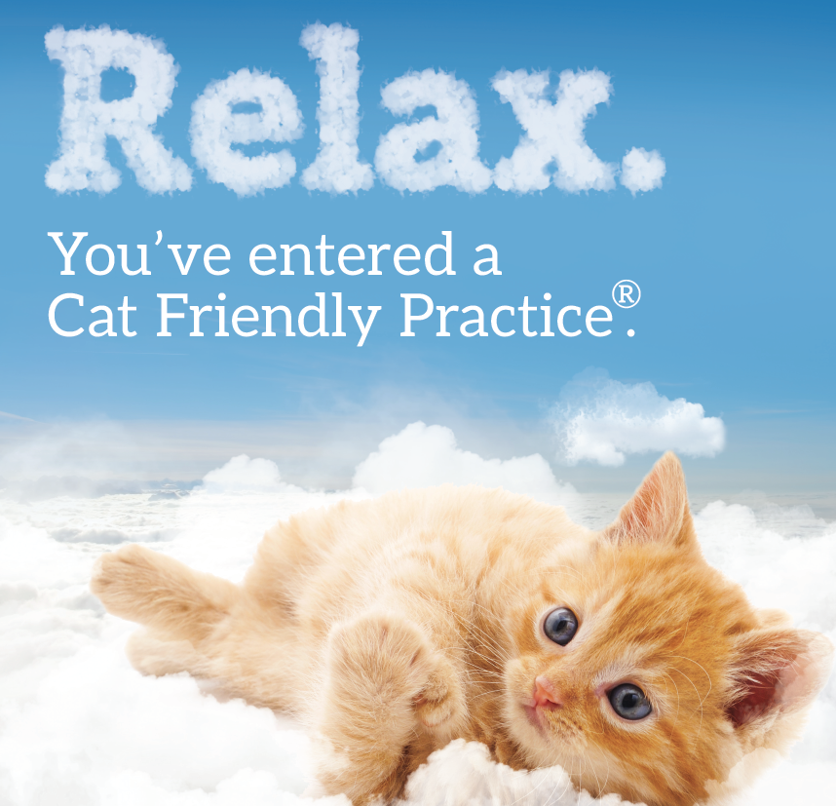
Optimizing the Clinic Environment
Saffire 2024

Slide 9
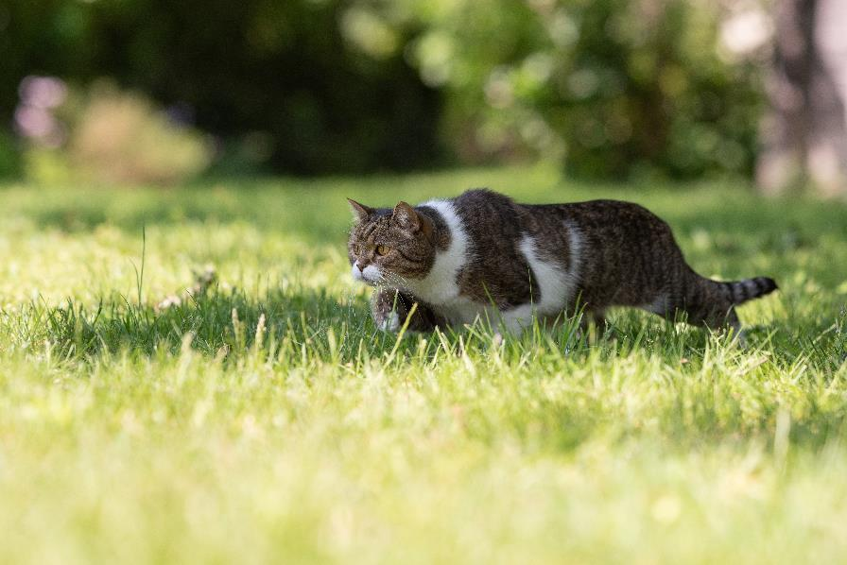
The Cat Inside It’s Natural Environment
Skilled hunter
Heightened sense of smell, hearing, vision, and tactile response
Solitary survivor
Hide illness and pain as a survival mechanism
Territorial animal
Saffire 2024
Notes:
We must understand a cat in it’s natural environment to help create a Cat Friendly Environment at the hospital.
Cats are skilled hunters with a heightened sense of smell, hearing, vision, and tactile response.
They are solitary survivors and have an excellent ability to sense and avoid danger.
By nature, they hide illness and pain as a survival mechanism.
They are territorial animals who require a sense of control, safety, and familiarity in their physical and social environment.

Slide 10
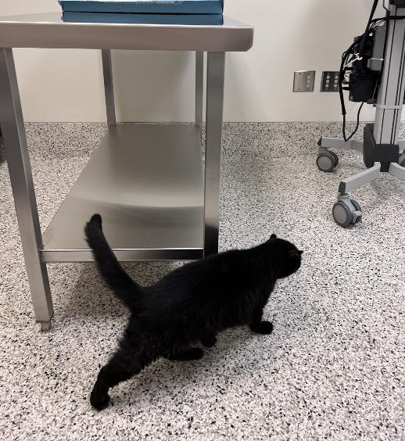
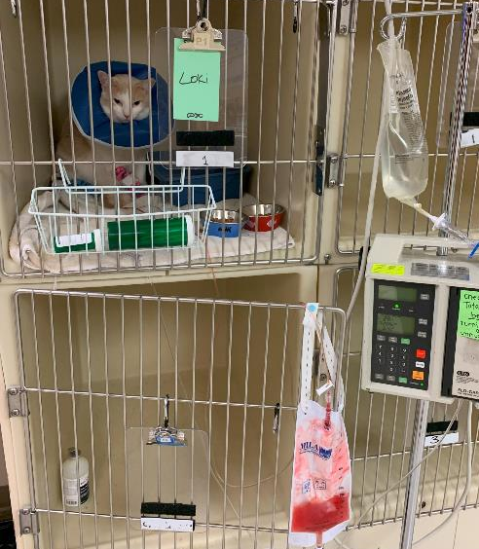
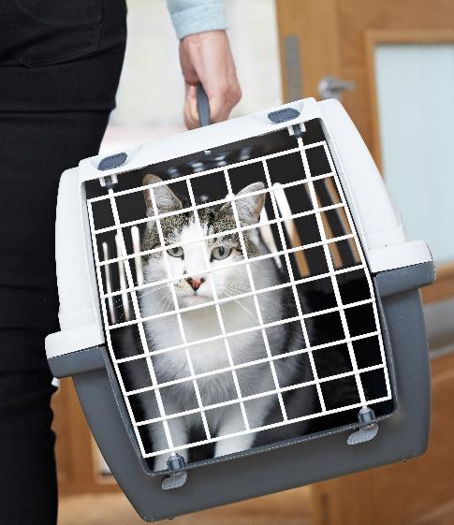
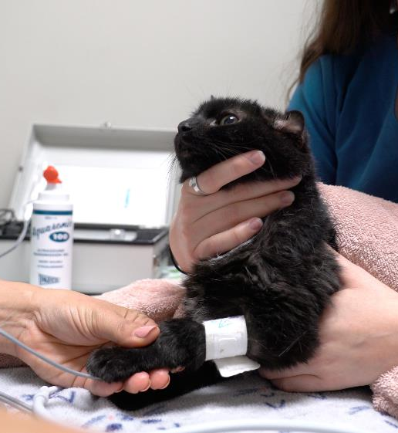
What Happens to Patients in the Hospital Setting?
Removed from familiar territory
Inability to escape or hide
Exposure to unfamiliar sounds/smells/sights/other animals
Changes in routine (altered feeding and sleeping times, extended exposure to light)
Restriction of movement (IVC, E-collars, bandages)
Unfamiliar food
Lack of predatory & play behavior
Restraint for procedures and examination
Key Point: Many causes of distress occur in the hospital environment
Saffire 2024
Notes:
Our first goal is to IDENTIFY CAUSES of distress in the hospital environment.
Cat Friendly strategies have been developed for hospitalized patients to reduce as many causes of environmental distress as possible in addition to avoiding stressful human interactions while still meeting the cats’ daily needs.

Slide 11
Distress: Unpleasant emotional experience that is harmful to one’s mental wellbeing. (Taylor 2022, Rodan 2022)
Decreased food intake and poor recovery from illness
Negative emotional state
High emotional arousal
Distress
Saffire 2024
Notes:
Those who are highly aroused will be less inclined to prioritize food intake.

Slide 12
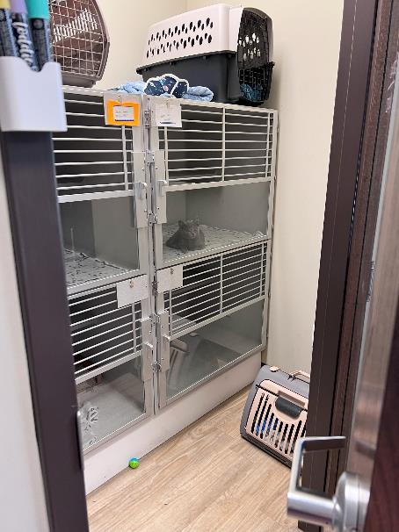
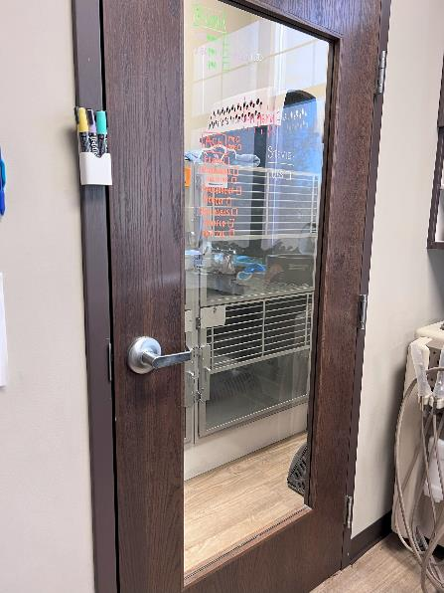
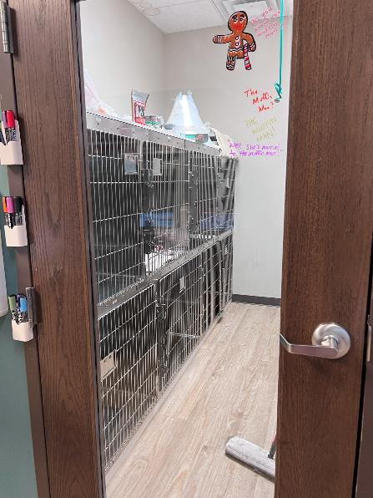
Create a QUIET environment!
Saffire 2024

Slide 13
Optimizing the Clinic Environment
Calming synthetic pheromones near the hospitalization area should be used
Saffire 2024
Notes:
Maintaining special senses are also crucial to their environment. – they can be overwhelmed in a clinic (new smells, sounds, etc.)

Slide 14
Optimizing the Clinic Environment
Familiar bedding and toys should be kept with the patient and only removed when soiled
Provide soft & warm bedding to help patient maintain body heat
Minimize cleaning of the kennels with harsh chemicals to prevent removal of familiar scents
Saffire 2024

Slide 15
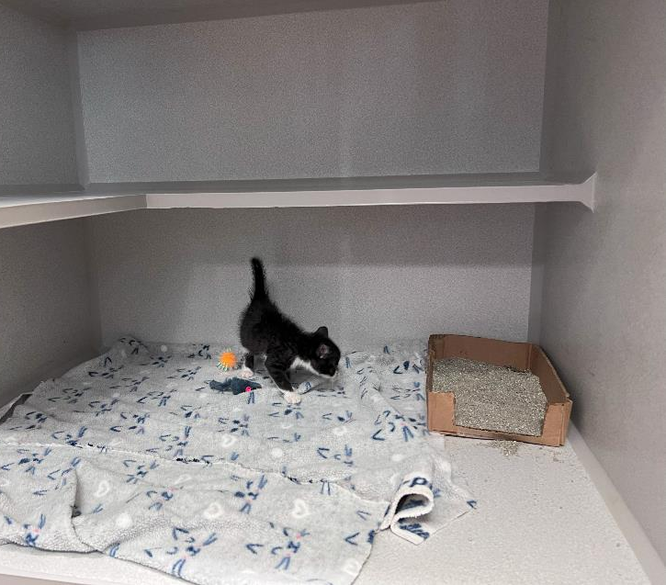
Optimizing the Clinic Environment
Litter box considerations:
Patient size
Mobility issues?
Place as far away from food and water as possible
Saffire 2024
Notes:
When selecting a litter box, choose a size that fits with an individual’s size and mobility.

Slide 16
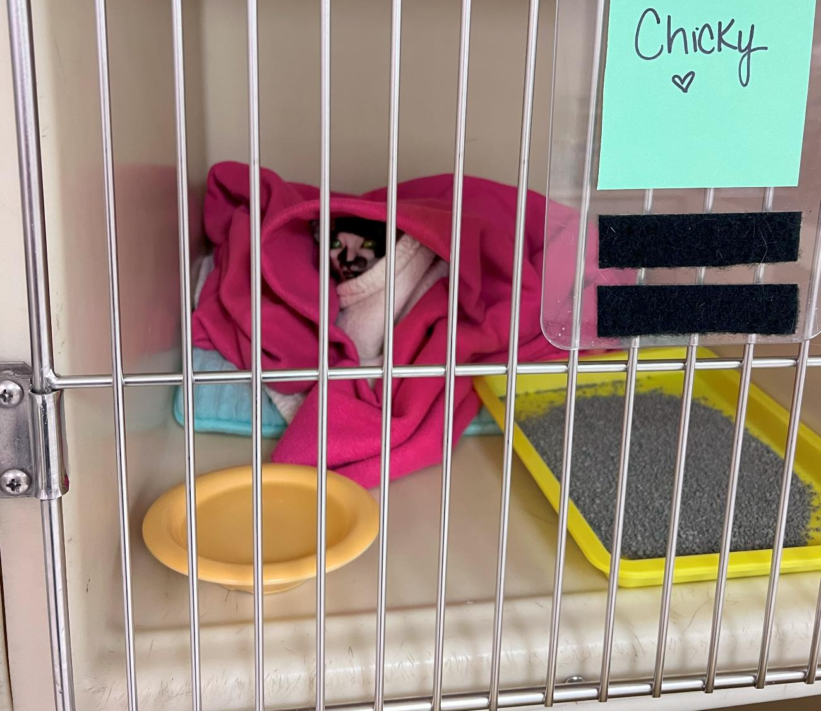
Optimizing the Clinic Environment
Offer Hideaway spaces
Cardboard boxes
Carrier or litter box lined with a soft blanket
Cover the cage with a blanket
Dim lighting
Saffire 2024

Slide 17
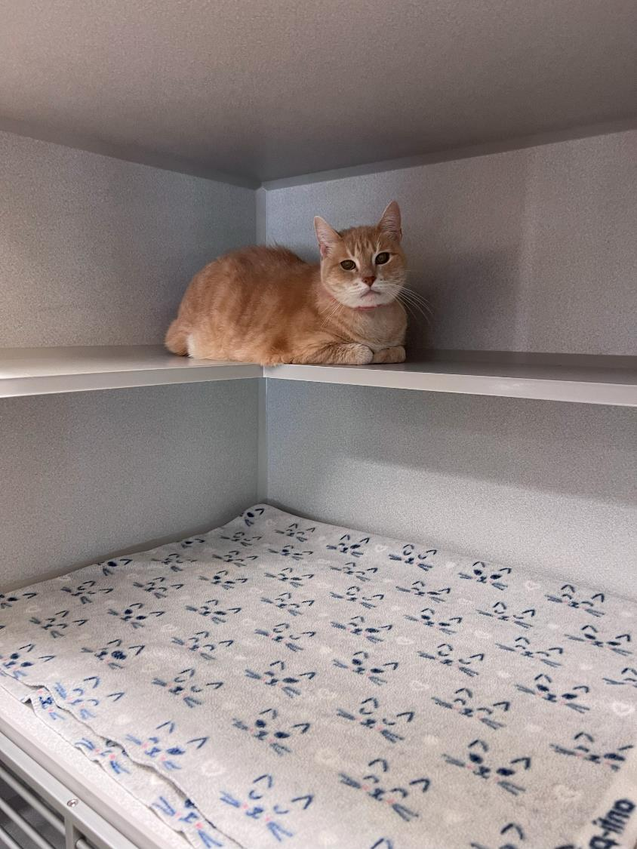
Optimizing the Clinic Environment
Human interactions:
Nurses/technicians should move quietly, slowly, and predictably
Avoid direct eye contact, if eye contact is made, blink SLOWLY
Avoid use of strong perfumes and air fresheners
Saffire 2024
Notes:
Human interactions should be carefully implemented.

Slide 18
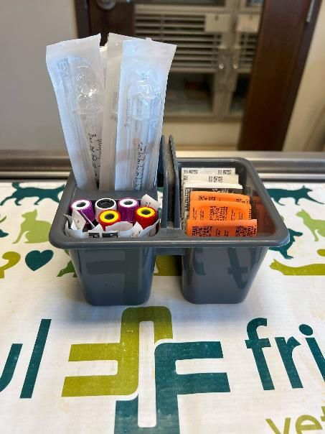
Optimizing the Clinic Environment
Human interactions:
Pain & FAS score prior to any procedure
Anticipate the need for analgesia!
Restraint (if needed) should involve continuous contact to avoid startling the cat
Collect all required equipment to reduce traffic around the patient
Allow patient to remain hidden during procedures (e.g., under a towel)
If possible, perform non-diagnostic procedures in the kennel
Saffire 2024
Notes:
Pain and FAS scoring is recommended prior to any procedure to properly prepare for an individual cat’s preference for handling and to administer analgesia, if indicated.

Slide 19
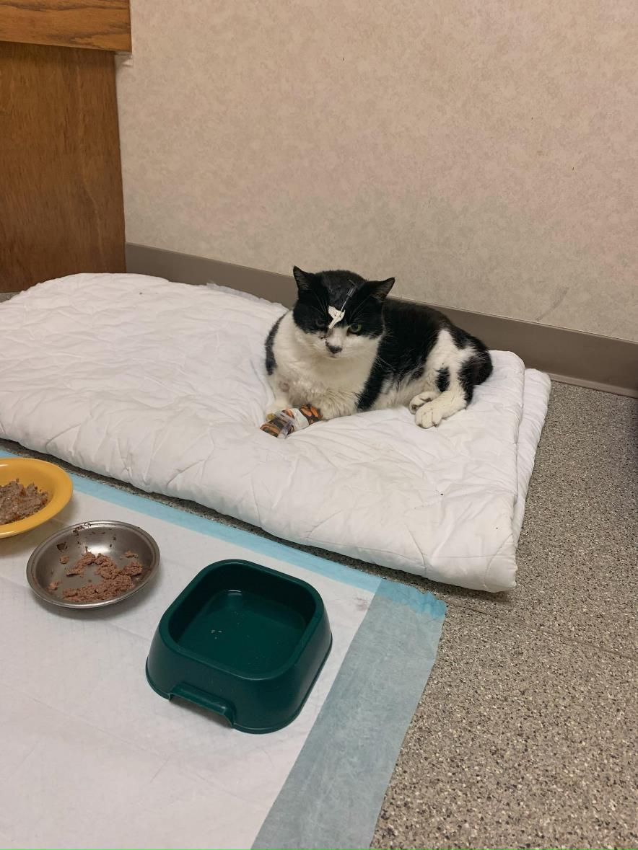
Optimizing the Clinic Environment
Human interactions
Positive, non-medical interactions improve mental health and physical wellbeing which in turn can speed recovery!
Grooming
Playing
Petting
Exercise outside of the kennel
Saffire 2024
Notes:
An easy grooming tip is to use a moist toothbrush to clean the cat’s face and head as it mimics licking.

Slide 20
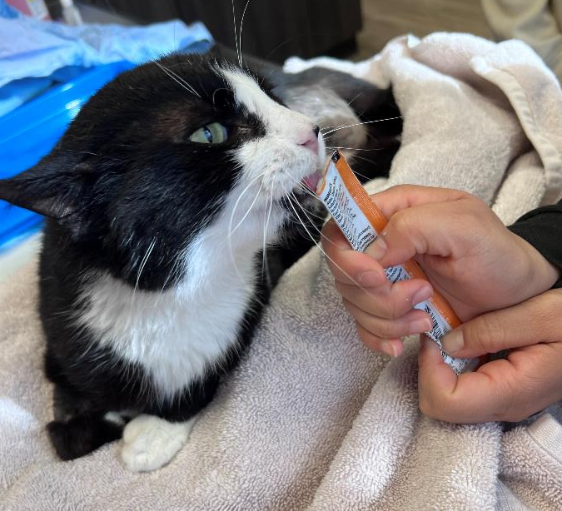
Increasing the Palatability of Food
Feed regular diet while hospitalized (if possible)
Some cats may be ‘social eaters’ and more responsive to social interactions
Offer treats or food items during a brief petting or grooming session
Saffire 2024
Notes:
As previously discussed, the nurse/technician should get a thorough understanding of the cat’s normal feeding routine and diet history from the caregiver.

Slide 21
Increasing the Palatability of Food
Offer small amounts of fresh food frequently
Remove any uneaten food 30 min after offering (do not leave with the cat for extended periods of time).
Avoid offering a ‘buffet’ of food
Saffire 2024
Notes:
‘Buffet’ of foods can be overwhelming and contribute to aversive behavior.

Slide 22
Increasing the Palatability of Food
Place food bowls where the cat can easily move away, if desired
Avoid placing food adjacent to litter boxes
Saffire 2024
Notes:
Exceptions might be cats staying overnight who are night eaters. However try to refrain from leaving super smelly food in a small space where they cannot get away.

Slide 23
Increasing the Palatability of Food
Flat or wide-brimmed food dishes
Warming food?
Any diet change should only be made after the cat returns home and has resumed a normal appetite
Including therapeutic diets!
Saffire 2024
Notes:
Warming the food can be helpful, however nauseous cats may prefer reduced scent from unheated food.
Regarding therapeutic diets, it is more important the cat eats something it likes than to force transition to a diet the patient does not like, as this can contribute to food aversions.

Slide 24
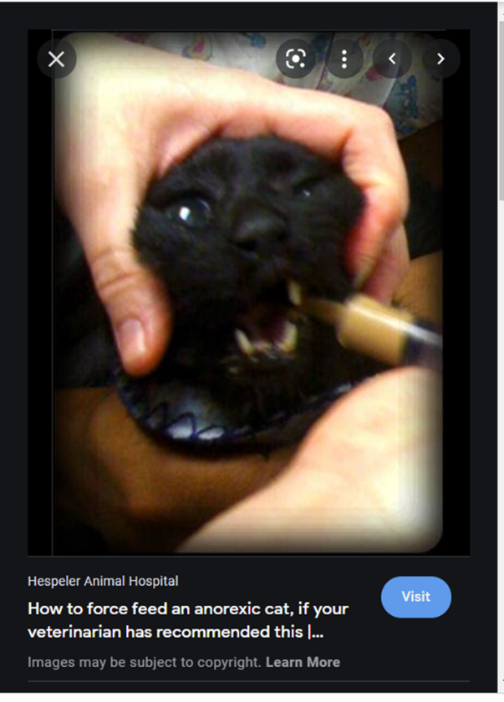
Syringe Feeding?
NEVER SYRINGE OR FORCE FEED AN ANOREXIC CAT!
Saffire 2024
Notes:
Syringe feeding, force feeding, and wiping food on the cat’s nose should not be performed as this will only contribute to food aversions and distress.

Slide 25
Still Not Eating?
Addressed the underlying medical condition
Optimized the hospital environment
Increased the palatability of food
Saffire 2024
Notes:
We have addressed the underlying medical condition, optimized the environment, AND increased the palatability of food… still not eating.?

Slide 26
When to Intervene?
Nutritional support should be instituted in any ill cat with inadequate food intake > 3 days
Key Point: Most cats that present for an illness may have already been anorexic/hyporexic for >24 hours!
Saffire 2024

Slide 27
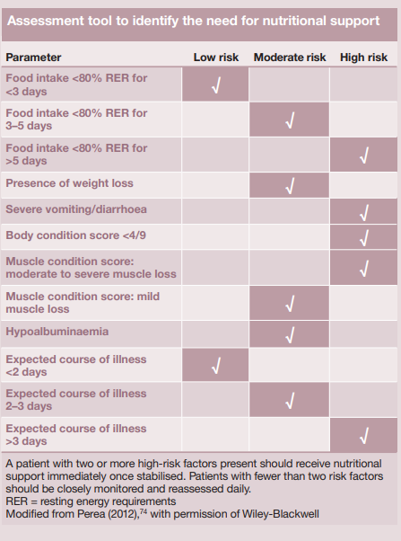
Reference: 2022 ISFM Consensus Guidelines on Management of the Inappetent Hospitalized Cat
Saffire 2024
Notes:
Every patient is different based on their particular illness and needs, response to therapy, and overall health condition.
Above is a great nutritional assessment tool from the Guidelines that helps identify risk factors that would make a particular patient at higher need for nutritional support or who might require earlier intervention.

Slide 28
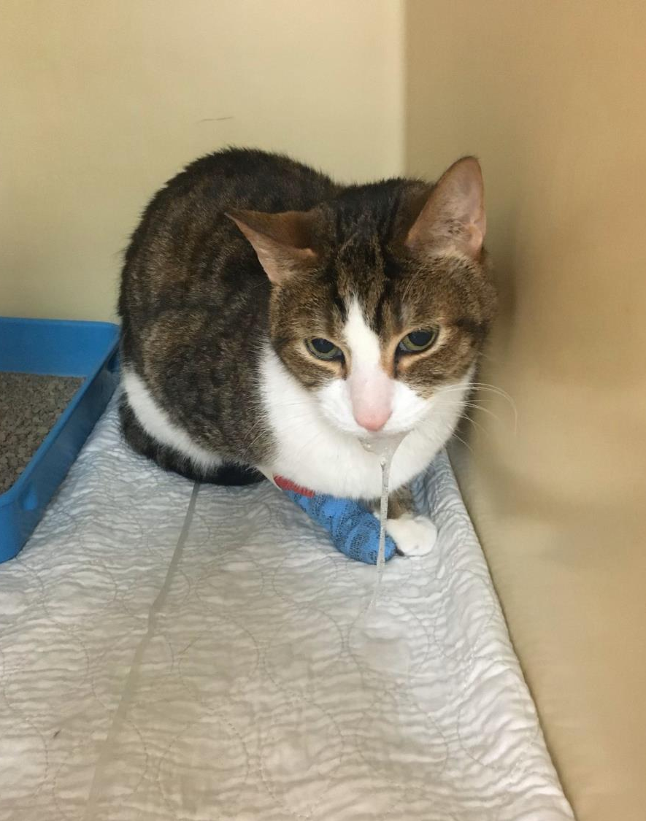
Initiating the Use of Anti-emetics and Appetite Stimulants
Saffire 2024

Slide 29
Once a patient is adequately resuscitated
Nutritional support is aimed at increasing nutritional intake:
Appetite stimulants & Antiemetics
Mirtazapine
Cyproheptadine
Enteral nutrition
Nasoesophageal tubes
Esophagostomy tubes
Capromorelin
Gastrostomy tubes
Maropitant
Ondansetron
Metoclopramide
Jejunostomy tubes
Nasogastric tubes
Saffire 2024
1. 2022 ISFM Consensus Guidelines on Management of the Inappetent Hospitalized Cat
Notes:
Initiating the use of medications such as antiemetics and appetite stimulants and if indicated, providing enteral nutrition via placement of feeding tubes.
Anti-emetics/Anti-nausea support should be initiated right away and continued throughout the hospital stay.

Slide 30
Appetite Stimulants
Indications
Contraindications
Encourage voluntary food intake
Short-term use
Long-term use
Behavioral reasons for inappetence
Consuming food, but not full MER
Unable to place feeding tube
Critically ill patients
Actively vomiting
Uncontrolled nausea
Physical condition causing decreased food intake
Uncontrolled pain
Ileus (fluid and gas distension of the bowel)
Saffire 2024
Notes:
INDICATIONS:
Short-term: during a diagnostic period, post-surgery
Long term: chronic diseases – CKD/Pancreatitis
Behavioral or environmental causes while hospitalized, high distress, or emotional arousal
CONTRAINDICATION: Physical condition that is causing decreased food intake :: Oral tumor/ulceration, esophageal stricture, mass occupying lesion causing stomach compression

Slide 31
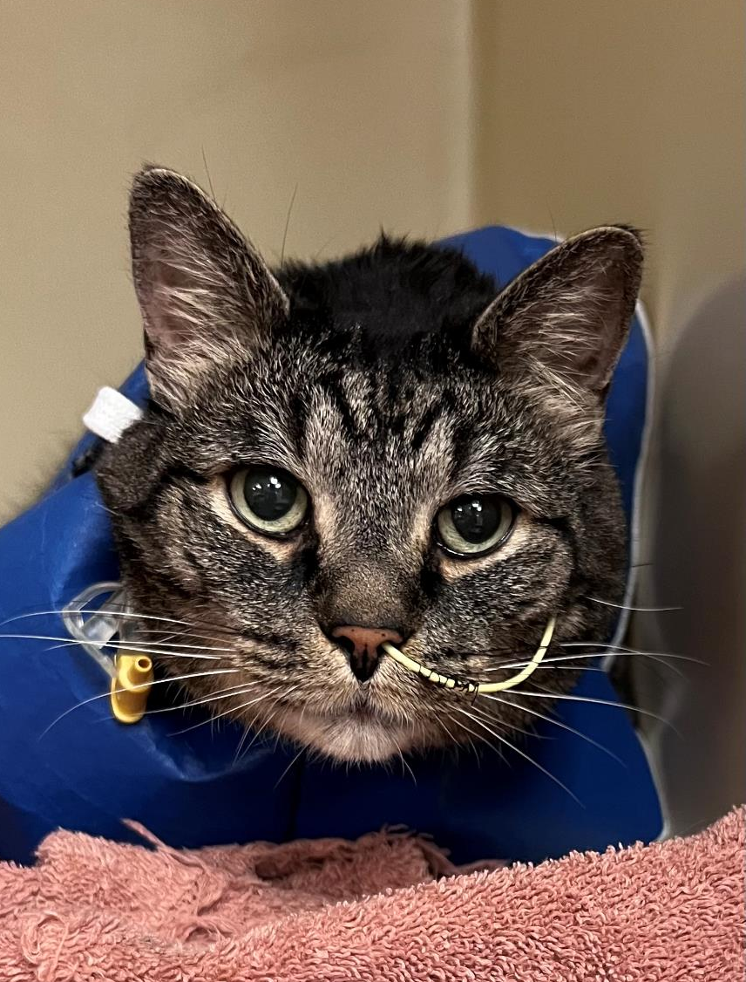
Enteral Nutrition
Saffire 2024
Notes:
Ultimately, the use of enteral nutrition via the placement of feeding tubes may be required. There are a variety of feeding tubes available for use in the feline patient including nasoesophageal/nasogastric tubes, esophagostomy tubes, gastrostomy tubes, and jejunostomy tubes.
NE tube placement can be readily maintained in general practice by a veterinary nurse/technician and in some cases even placed by a nurse/technician.

Slide 32
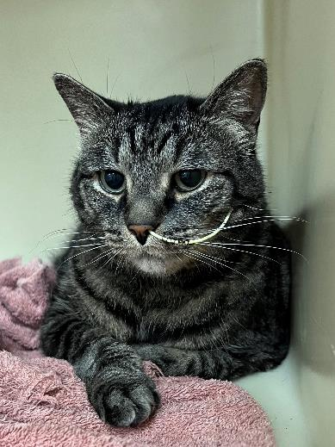
When to Consider Enteral Nutrition?
Patient is consuming < 80% RER/MER for 3 or more days
When a cat is physically unable to eat
When a patient is anticipated to not be able to consume adequate amounts of food
To facilitate medication administration at home by the caregiver
RER = Resting Energy Requirements MER = Maintenance Energy Requirements
Saffire 2024
Notes:
Read slide first
Hyporexia
Disorders of the jaw, oral cavity, pharynx
Following major surgery, undergoing chemo, progressive kidney disease
I had a cat once that only required the e-tube or medication administration at home.

Slide 33
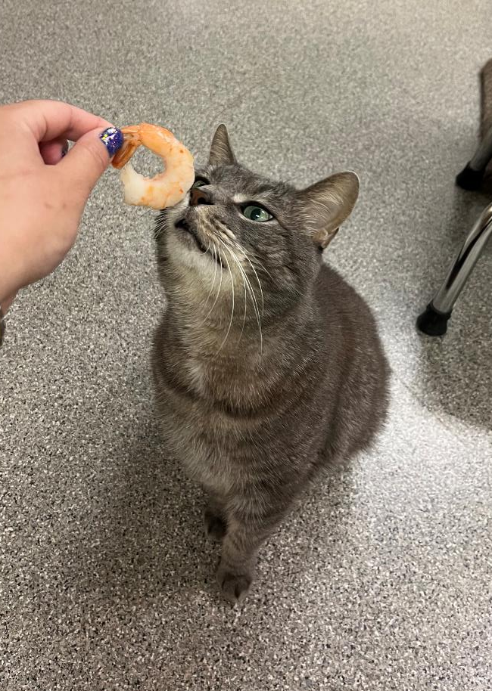
Thank you!
Ashlie Saffire, DVM, DABVP (Feline)
President, FelineVMA

