Slide 1
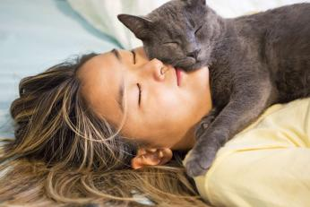
ALLERGIES TO CATS
A ONE HEALTH
PERSPECTIVE
Part Two
Peter Karczmar, MD, FACP
Diplomate, ABIM, Pulmonary, Critical Care and Sleep Medicine
Brown Physicians, Inc.
Assistant Professor of Medicine
Warren Alpert Medical School of Brown University
Providence, RI USA
pkarczmar@gmail.com

Slide 2
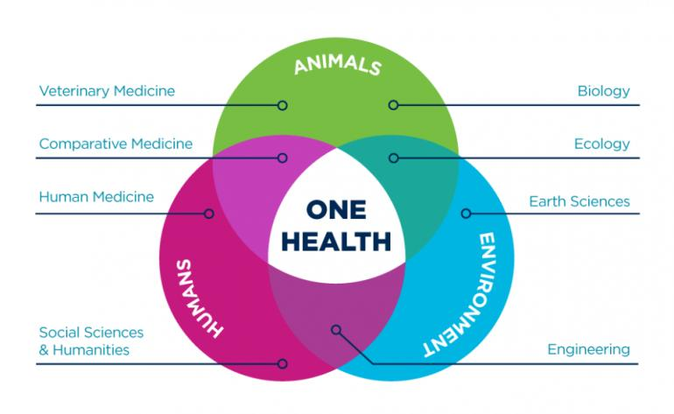
ucdavis.edu
Notes:
One Health exemplifies how different professions intersect and collaborate to achieve the mission of improving animal and human health.

Slide 3
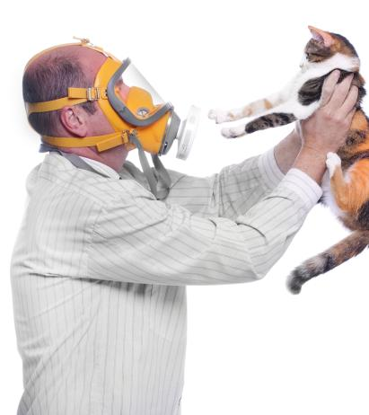
Are Cats a Risk Factor for Asthma &/or Allergies?

Slide 4
Are Cats a Risk Factor for Asthma &/or Allergies?
Exposure to dogs and cats in the first year of life and risk of allergic sensitization at 6 to 7 years of age. Ownby D, et al. JAMA 2002;288:963-972.
  Statistically significant decrease in pinprick sensitivity and IgE levels in children at 6-7 y/o if exposed to cats or dogs during first year of life.
A longitudinal analysis of wheezing in young children: the independent effects of early life exposure to house dust endotoxin, allergens, and pets. Litonjua AA, et al. J Allergy Clin Immunol 2002;110:736-742.
  Exposure to cat allergen and the presence of a dog in the home were both associated with decreased risk for wheezing.
Effect of cat and dog ownership on sensitization and development of asthma among preteenage children. Perzanowski MS, et al. AJRCCM 2002;166:696-702..
  Pet ownership was a strong negative risk factor for asthma among families with a history of the disease.
Presence and timing of cat ownership by age 18 and the effect on atopy and asthma at age 28. de Meer G, er al. J Allergy Clin Immunol 2004.
  Having a cat before age 18 protected against atopy to outdoor allergens, airway hyperresponsiveness and asthma. Acquiring first cat after age 18 showed a trend toward higher prevalence rates for asthma symptoms.
Pet ownership is associated with increased risk of non-atopic asthma and reduced risk of atopy in childhood: findings from a UK birth cohort. Collins SM, et al. Clin Exp Allergy 2015;45:200-210..
  Cat ownership during pregnancy and childhood was associated with a reduced risk of asthma at age 7.
Early exposure to cats, dogs and farm animals and the risk of childhood asthma and allergy. Ojwang V, et al. Pediatr Allergy Immunol 2020;31:265-272.
  Having a dog or cat in the house during the first year of life may protect against childhood asthma and allergies.
Notes:
Numbers of studies have shown a decrease in sensitivity to cats in children who are exposed to cats at a young age, which implies that these children may be less likely to develop cat allergies.

Slide 5
Are Cats a Risk Factor for Asthma &/or Allergies?
Lødrup Carlsen, KC, et al. PlosOne 2012
  Global Allergy and Asthma European Network (GA²LEN)
Meta analysis of 11 European birth cohorts (>22,000 children)
Development of asthma &/or allergic rhinitis in children 6-10 years old who were exposed to furry pets and birds during first 2 years of life
Pet exposure neither increased nor decreased the risk of asthma &/or allergic rhinitis
Notes:
This large study showed that exposure to cats in children during the first two years of life did not lead to increased asthma, or allergic rhinitis.

Slide 6
How Can We Reduce Cat-Related Allergies?
Avoidance techniques and dander exposure mitigation
Medical therapies
  Steroids, bronchodilators, leukotriene modifiers, antihistamines, biologics
  Immunotherapy
Dietary modifications to decrease Fel d 1 exposure
Cat vaccination to reduce Fel d 1 production
Cat gene modification
Notes:
There are many different approaches to mitigating cat allergies, some still in developmental stages.

Slide 7
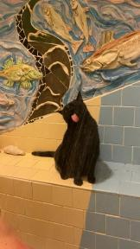
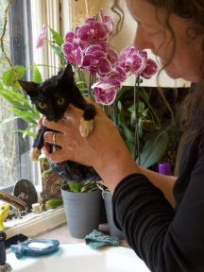
Measures to Reduce Exposure to Cat Allergens
No convincing evidence for “hypoallergenic” breeds (“hair vs. fur”)
  No evidence for differential shedding of allergens by “hypoallergenic cats”
Female and neutered male cats produce less Fel d 1
Regular cat washing (!)
Keep the cat out of the bedroom
Improve ventilation
Use air purifiers with HEPA filters
Frequent vacuuming
Use mattress and pillow covers with mean pore size <6 µm
Notes:
Dust mites live in mattresses and pillows and if covers are used with pore sizes that keep dust mites contained or trapped, it can help reduce allergic symptoms. Fel d1 is too tiny to be impacted by pore size restrictions.

Slide 8
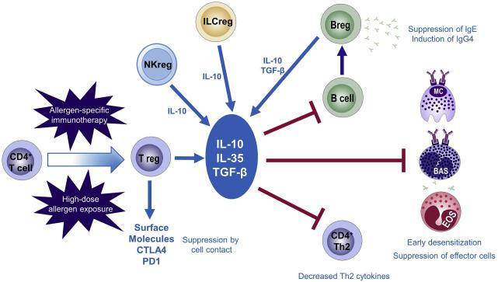
Cat Allergy Response Reduction in Humans:
Immunotherapy
Kucuksezer UC, et al. Allergol Int 2020;69:549-560.
Notes:
Allergen-specific CD4⁺ T lymphocyte regulatory cells are induced to produce regulatory cytokines resulting in immune suppression of allergic responses.
Treg cells suppress Th2 cell, eosinophils, basophils leading decreased IgE production and inducing IgG4 ‘production.

Slide 9
Cat Allergy Response Reduction in Humans:
Immunotherapy
Subcutaneous allergen specific immunotherapy (SCIT):
  Cat dander extract
  Administration of increasing doses of allergens → induction of allergen-specific IgG Abs → production of allergen-neutralizing Abs
  Limited number of high-quality studies with mixed results
  Difficult to standardize, side effects including risk of anaphylaxis
Sublingual immunotherapy (SLIT):
  Safer and easier to administer
  Only 2 studies with conflicting results on efficacy
Intralymphatic immunotherapy (ILIT):
  One study in 2012
Notes:
Immunotherapy is administered by various methods and can reduce sensitivity to allergens. This slide shows three examples—SCIT is via SQ injection, SLIT is by an oral liquid, and ILIT is through an injection into lymph nodes.

Slide 10
Cat Allergy Response Reduction in Humans:
Novel Therapies
Anti-Fel d 1 monoclonal IgG antibodies:
  Improved rhinitis symptoms in cat allergic patients
  Orengo JM, et al. Nat Commun 2018;9:1421.
  Shaji MH, et al. Am J Respir Crit Care Med 2021;204:23-33.
Cat-PAD (ToleroMune® Cat):
  Synthetic peptide immuno-regulatory T-cell epitopes derived from Fel d 1
  Long-term improvement in rhino-conjunctivitis symptoms at 2 years
  Couroux P, et al. Clin Exp Allergy 2015;45:974-981.
Notes:
These are examples of some novel therapies for treating cat allergies, but more work is needed to assess efficacy. The advantages of these two examples is they give much longer control than conventional immunotherapy.

Slide 11
Measures to Reduce Exposure to Cat Allergens
Specialized food:
Purina Pro Plan LiveClear
  Chicken-derived IgY Abs to Fel d 1 in egg yolks added to cat food
  Reduced allergens on cat hair and dander by ~50%
  Improved allergic symptoms in cat bedding-exposed subjects
  Satyaraj E, Wedner HJ, Bousquet J. Allergy 2019;74 (Suppl. 107):5-17.
Notes:
Small studies have shown improved allergic symptoms in humans exposed to cats. The diet reduces the amount of Fel d1 in the environment by binding it to the cat’s saliva so it no longer acts as an allergen. The amount of reduction varies with individual cats, much like the amount of Fel d1 that is produced varies from cat to cat.

Slide 12
Measures to Reduce Exposure to Cat Allergens
Cat vaccination:
  Fel-CuMV (HypoCatTM)
  Induced high-affinity Abs → neutralizing Fel d 1 → ↓Fel d 1 in cat secretions
  Decreased allergic symptoms in cat-allergic subjects
  Thoms F, et al. J Allergy Clin Immunol 2019;144:193-203.
  Viruses 2020;12:288-307.

Slide 13

Cat Gene Modification
CRISPR Gene Editing of the Major Cat Allergen, Fel d 1.
  Brackett N, et al. The CRISPR J. 2022;5:213-223.
Notes:
There is research currently being done to see if cats can be gene edited to eliminate Fel d1. Unfortunately, there is not a clear understanding of the role of Fel d1, so eliminating it may result in unintended issues or problems for cats.

Slide 14
Advice to Patients About Living With Cats
Having a pet is beneficial to our mental and physical health.
Living with a cat increases likelihood of sensitization to the cat, but may not result in allergic symptoms.
Living with a cat tends to decrease allergic symptoms in reactive people over time.
Studies suggest that living with a cat may decrease the risk of cat allergies, especially when exposure occurs during childhood.
Most people with environmental allergies are also allergic to other allergens in their home.
Do not advise removing the cat from the home unless it’s clear that:
  The cat is the only trigger for allergic symptoms.
  Allergic symptoms persist despite medical therapy and measures to reduce allergen exposure.
Notes:
People who have cat allergies will most commonly become less allergic with consistent exposure to individual cats.

Slide 15

Summary
Cat allergies are the second most common cause of environmental allergies in humans.
Mediated by IgE-specific response to Fel d 1.
Exposure to cats, especially at a young age, has been shown to result in decreased allergic sensitivity to cats.
Cats are integral to human physical and emotional well-being.
People with cat allergies who love their cats are unlikely to abandon their cats even if advised by their doctor.
Evolving research into decreasing Fel d 1 production in cats and decreasing human exposure to Fel d 1 may eventually lead to a “non-allergic” cat.
It is our responsibility as physicians and veterinarians to promote the human-animal bond and help people balance the benefits of cat companionship while minimizing potential allergic symptoms.
Notes:
My patients always want to keep their cats, and as their physician, I strongly encourage them to do so! Life with cats is always better!

Slide 16
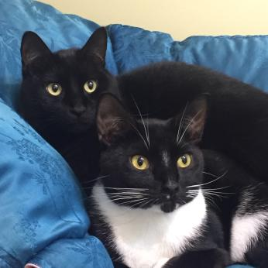
If you have allergies, the longer you live with your cats the better your symptoms (and life!) will be!

