Slide 1
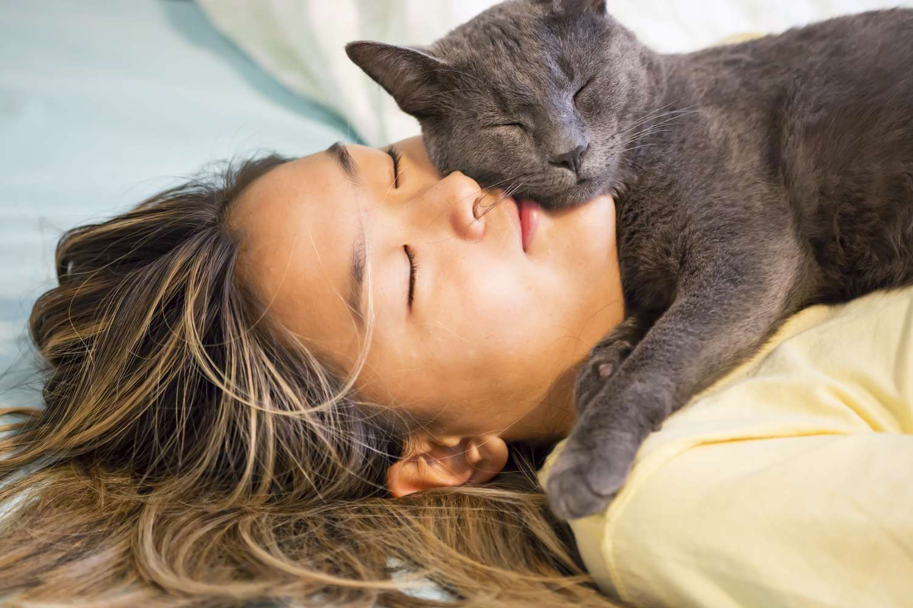
ALLERGIES TO CATS
A ONE HEALTH
PERSPECTIVE
Peter Karczmar, MD, FACP
Diplomate, ABIM, Pulmonary, Critical Care and Sleep Medicine
Brown Physicians, Inc.
Assistant Professor of Medicine
Warren Alpert Medical School of Brown University
Providence, RI USA
pkarczmar@gmail.com

Slide 2

ucdavis.edu
Notes:
One Health exemplifies how different professions intersect and collaborate to achieve the mission of improving animal and human health.

Slide 3

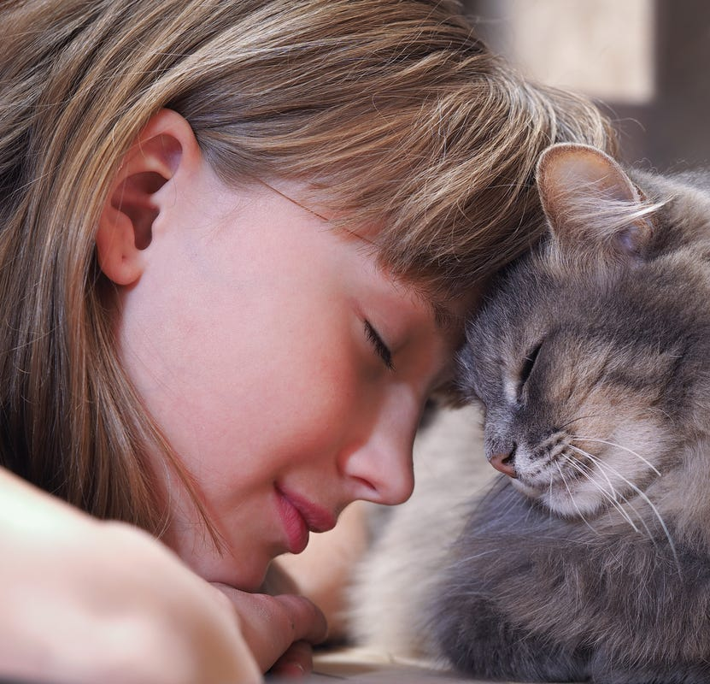
Human-Animal Bond
“A mutually beneficial and dynamic relationship between people and animals that is influenced by behaviors that are essential to the health and well-being of both.” (AVMA 2016)
Biophilia hypothesis: humans possess an innate tendency to seek connections with nature and other forms of life
~60% of US population has a household pet
Approx. $30 billion spent on pet food, $20 billion on veterinary care in US
Secondary (or primary) “family” members
~20% of US households adopted pets during the pandemic

Slide 4
Pet Companionship
Positives:
Companionship
Reduces loneliness
Provides unconditional love
Reduces stress and anxiety
Teaches responsibility
Improves physical and emotional health
Reduced risk of allergies and eczema in children
Negatives:
Maintenance
Expense
Property damage
Time constraints
Zoonoses
Bites
Allergies
Schoos A-MM, Nwaru BI, Borres MP. J Allergy Clin Immunol. 2021;147:1164-73.

Slide 5
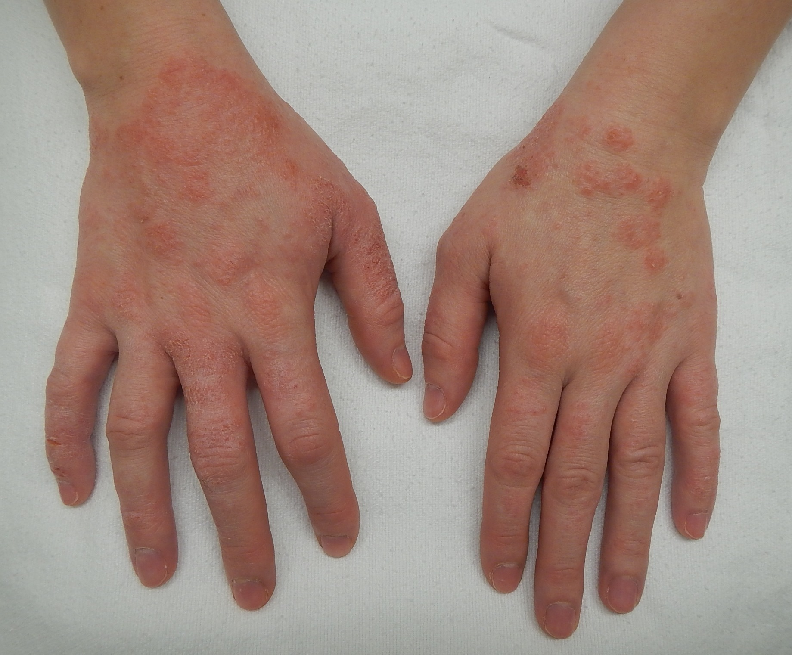
Allergic Disease
IgE-mediated immune response (hypersensitivity reaction) to environmental allergens following sensitization →
  Rhinitis/sinusitis
    Rhinorrhea, nasal obstruction, cough, itching, fatigue, sleep disruption
  Allergic conjunctivitis
    Bilateral itching, tearing, and/or burning of the eyes
  Eczema
    Intensely itchy erythematous patches involving scalp, extremities, or trunk
  Asthma
  Food allergies
  Anaphylaxis

Slide 6
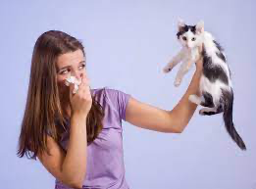
Allergic Disease
Asthma prevalence among youth in US has tripled and food allergies have doubled since 1970s
Genetic evolution unlikely explanation for this increase
Possible explanations:
  Urbanization → ↑ indoor allergen exposure
  Increasing use of antibiotics → change in microbiome
  Global warming → longer and more intense exposure to allergens (e.g., pollens)
  Hygiene hypothesis – less exposure to viruses, bacteria, helminths → ↓type 1, ↑type 2 immune response → atopy and auto-immune diseases
Possible role of epigenetic change (DNA methylation, histone modification, non-coding RNA-associated gene splicing)
Notes:
Asthma prevalence has been steadily increasing worldwide and there isn’t a singular explanation of why this is happening--it appears to be multifactorial.

Slide 7
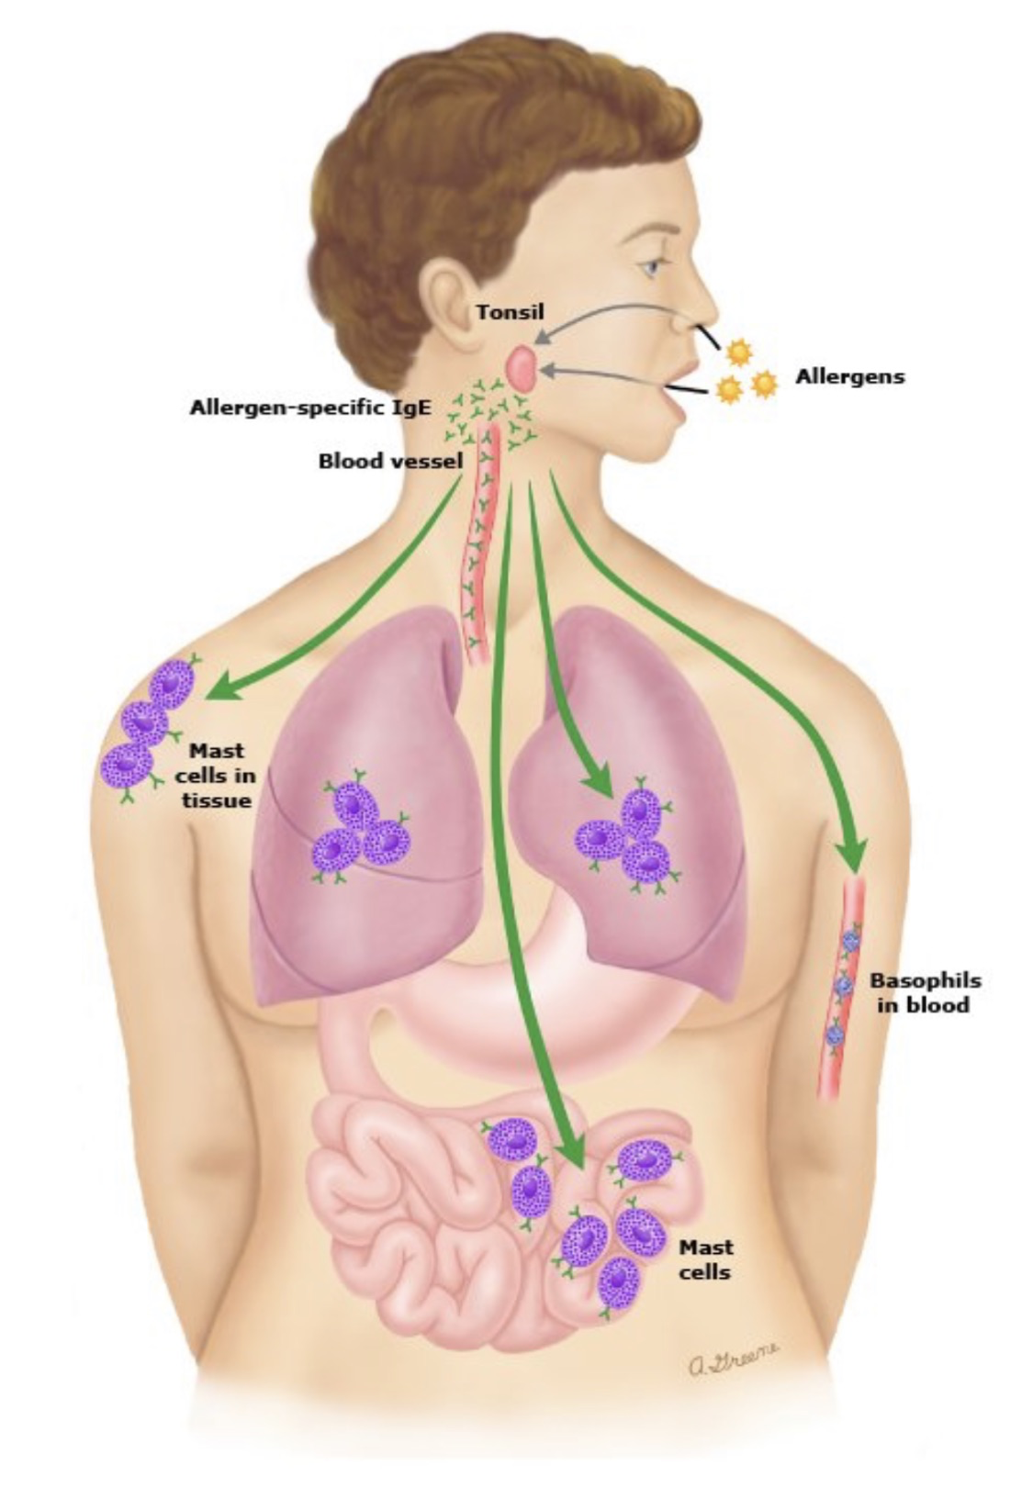
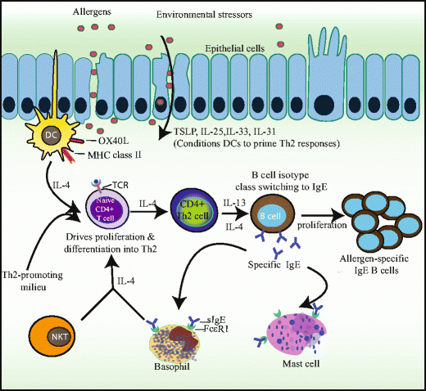
Allergic Sensitization
Sinder SB, et al. Clinic Rev Allerg Immunol 2018;55:190-204.
Notes:
Mucosal dendritic cells capture allergen and transport to the lymph nodes.
Within LNs, allergen-specific T 2 helper cells proliferate and produce Interleukin-4 and IL-13 favoring B cell isotype class switching.
A memory pool of allergen-specific B and Th2 cells are generated.

Slide 8
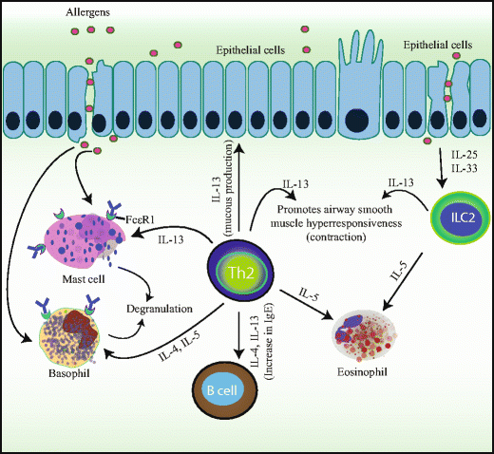
Allergic Response
Sinder SB, et al. Clinic Rev Allerg Immunol 2018;55:190-204.
Notes:
Previously sensitized allergens lead to IgE cross-linking on and activation of basophils and mast cells causing degranulation and release of histamine, proteases, prostaglandins, leukotrienes and cytokines. Allergen-specific Th2 cells are activated and produce IL-4, IL-5 and IL-13 which maintain allergen-specific IgE levels, eosinophilia, mucus production and recruitment of inflammatory cells.

Slide 9
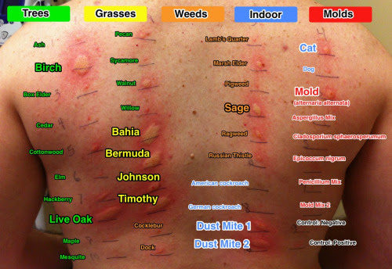
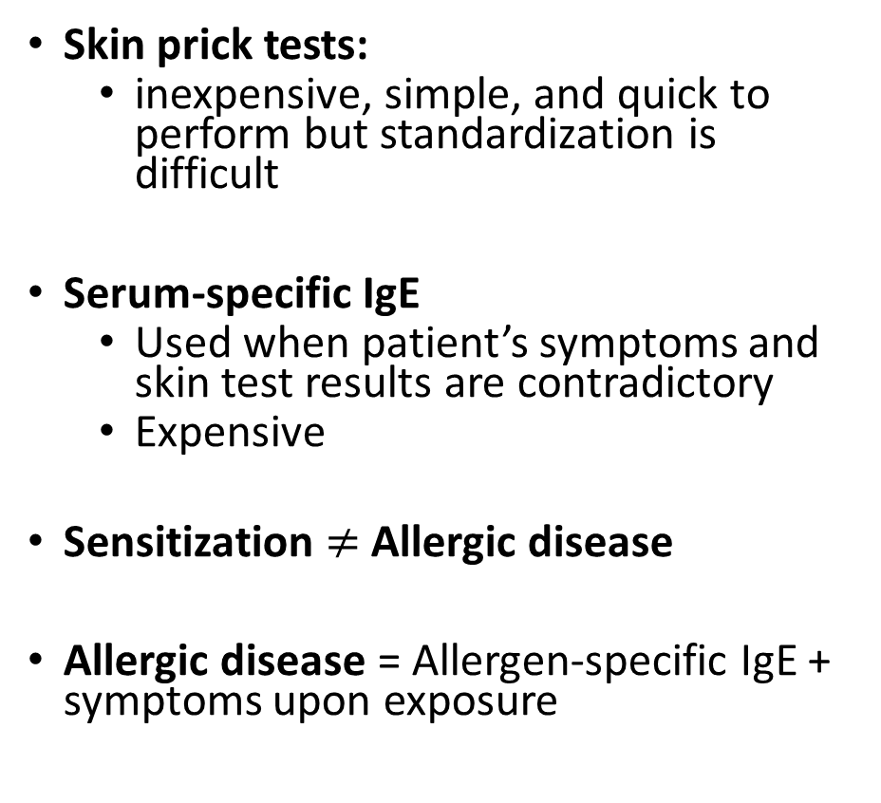
Diagnosing Allergies
Skin prick tests:
  inexpensive, simple, and quick to perform but standardization is difficult
Serum-specific IgE
  Used when patient’s symptoms and skin test results are contradictory
  Expensive
Sensitization $≠$ Allergic disease
Allergic disease = Allergen-specific IgE + symptoms upon exposure
Notes:
Sensitization means IgE antibodies are generated in response to an environmental allergen, but that doesn’t necessarily mean that someone will develop allergic symptoms.

Slide 10
Cat Allergens
Satyaraj E, Wedner HJ, Bousquet J. Allergy 2019;74 (Suppl. 107):5-17.
Notes:
Fel d1 is the most important feline allergen in humans.

Slide 11
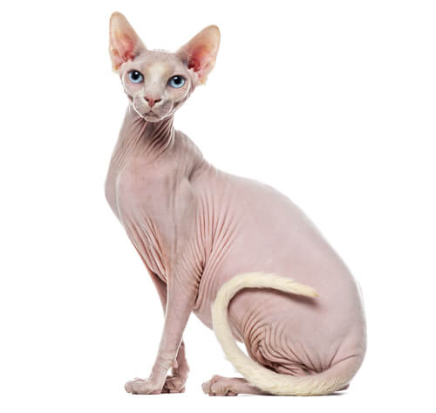
Fel d 1
35-38 kDa glycoprotein - 2 identical heterodimers
Major allergen of domestic cats
Biological function unknown
Salivary and sebaceous glands are the main production sites
Cat grooming behavior spreads Fel d 1 to skin, fur, and the environment
Uncastrated males > castrated males > females
Adult cats > kittens; younger cats > older cats
Coat color and hair length do not matter
Head > chest
Up to 80-fold difference in salivary Fel d 1 levels among individual cats
There are no hypoallergenic breeds (? Siberian, Siamese, Bengal, Sphynx)
Found in 99% of US homes; also in classrooms, cars, stores, and planes
Lightweight and sticky
60% of airborne Fel d 1 sticks to small respirable particles, which are inhaled
  Satyaraj E, Wedner HJ, Bousquet J. Allergy 2019;74 (Suppl. 107):5-17.
Notes:
People become exposed to Fel d1 because it is so prevalent in the environment, and its small size makes it easy to inhale.
Fel d1 can remain in the environment for prolonged periods.
Major allergen of domestic cats. Anti-Fel d 1 specific IgE found in serum of 80-95% of patients allergic to cats
The biological function of Fel d 1 is unknown.
? transport of steroids, hormones, or pheromones
While washing cats reduces Fel d 1 on skin and fur. The levels return to baseline in two days.

Slide 12
Cats and Allergies
Allergic sensitization to cat allergens
  Presence of Fel d 1-specific serum IgE antibodies
  10-25% of patients are sensitized to cat allergens in allergy clinic-based studies
  5.5x increase between 1970s and 1990s
  95% of cat-allergic patients produce IgE to Fel d 1
Anti-Fel d 1-specific IgE levels correlate with severity of allergic symptoms
Threshold for symptoms: 8 µg Fel d 1/g of dust (typical house levels: 10-1000 Fel d 1 µg/g of dust)
~30% of asthma attacks attributable to cat allergen exposure in sensitized subjects
One of the main reasons why owners abandon cats to shelters
Most cat-allergic people with asthma are sensitized to cats but do not live with cats
Children living in a house with a cat are less likely to be sensitized to cat allergens
Highest levels of cat exposure → decreased sensitization
Living with a cat → cat-specific tolerance
  IgG Abs to Fel d 1 increase as level of cat allergen exposure increases
  Increased IgG₄ levels are associated with decreased symptoms
  Similar response as immunotherapy
Similar findings not seen with allergies to dust mites and cockroaches
Notes:
Sensitization from prior exposure to cats primes the pump in individuals who have allergic disease so when they become exposed to more cats, or to Fel d1, they develop allergic symptoms.
Allergies is one of the main reasons people relinquish cats to shelters. However, if they want to keep their cat and their doctor says get rid of the cat because of allergies, people often change doctors.

Slide 13

Asthma: Overview
  Most potentially dangerous complication of cat allergies in humans
  A heterogeneous disease characterized by airway inflammation (eosinophils, neutrophils, lymphocytes) → variable airflow limitation and hyperresponsiveness on spirometry
  Defined by the history of respiratory symptoms such as wheezing, shortness of breath, chest tightness and cough that varies over time and intensity
  Can occur at any age
  Some patients can develop persistent airway structure changes with smooth muscle hypertrophy, sub-basement membrane fibrosis and chronic mucus hypersecretion
Notes:
Asthma is an increasingly common problem, with 8% of the population clinically affected. Cat allergies are a known asthma trigger, and in very reactive people can cause significant disease.

Slide 14
Asthma: Epidemiology
Prevalence
  ~240 million worldwide
  Prevalence varies among countries:
    ~8% in US (M>F in children, F>M in adults, Black>White)
Increasing prevalence since 1970s
  Increased clinician and public awareness
  Increased risk factors:
    Obesity
    Tobacco smoke exposure
    Low vitamin D levels
    Urbanization → exposure to air pollution and indoor allergens

Slide 15
Asthma: Diagnosis
Symptoms: Episodic wheezing, cough, shortness of breath, chest tightness
Triggers: Exercise, cold air, allergens, tobacco smoke, occupational exposure, air pollution, respiratory infections, aspirin
Personal or family history of atopy
History of asthmatic symptoms as a child
Spirometry: >10% improvement in airflow with administration of short-acting bronchodilator OR >20% decrease in airflow with administration of a bronchoconstrictor (methacholine, mannitol)
Increased eosinophils on bronchial washings
Fractional exhaled nitric oxide (FeNO)

Slide 16

Asthma: Triggers
Allergies--including cat exposure
Occupational exposures
Air pollution
Smoking
Exercise (esp. in cold air)
Viral, bacterial, and parasitic infections
Stress
Medications (Aspirin, beta-blockers)

Slide 17
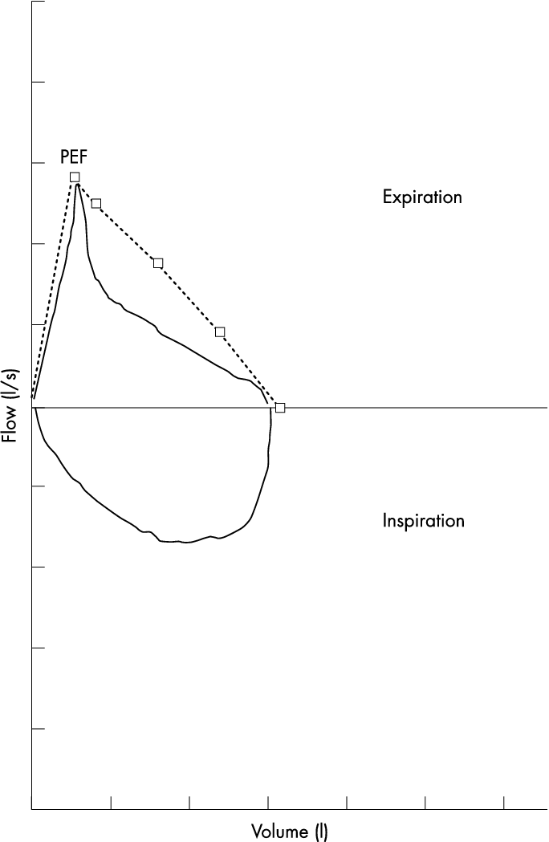
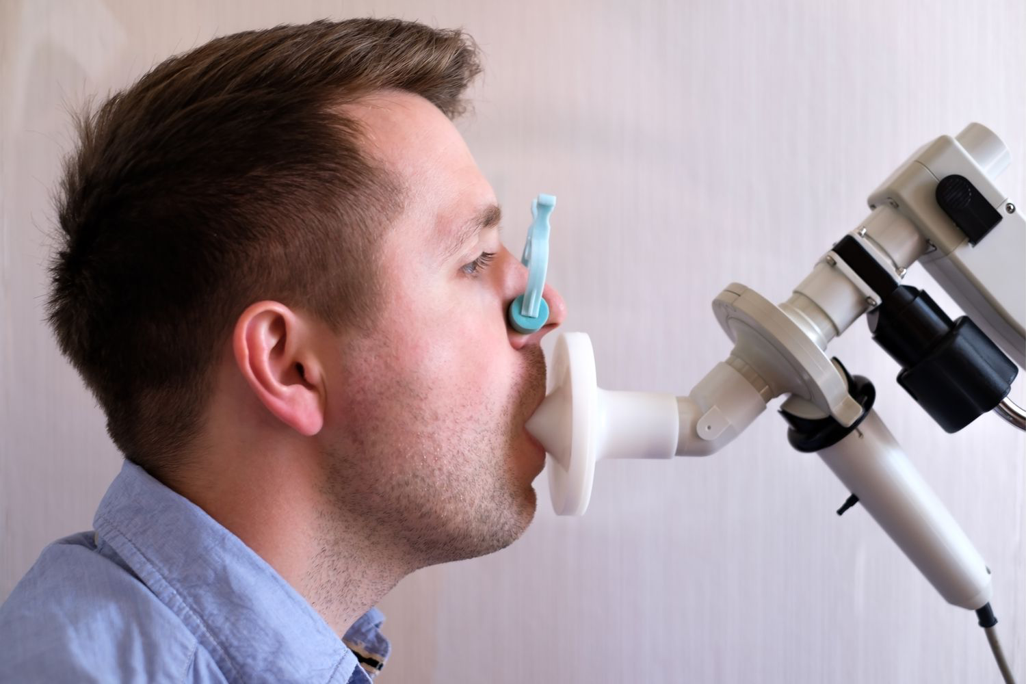
Notes:
This is an example of spirometry, used to diagnose asthma in humans. The chart shows a flow-volume loop that illustrates airflow obstruction seen in asthma.

Slide 18
Asthma Phenotypes
Borish L. Ann Allergy Asthma Immunol 2016;117:108-114.
Notes:
Allergic asthma is eosinophilic, but asthma can also be triggered by non-allergic inflammation, such as with air pollution, medications, or stress.

Slide 19

Not Everyone Who Wheezes has Asthma
Can be mistaken for asthma:
  Chronic obstructive pulmonary disease
  Bronchitis
  Heart disease
  Vocal cord dysfunction
  Gastroesophageal reflux
  Subglottic stenosis and upper airway tumors
  Factitious asthma
Notes:
Factitious asthma is caused by emotional stresses that result in abnormal closure of the vocal cords.

Slide 20
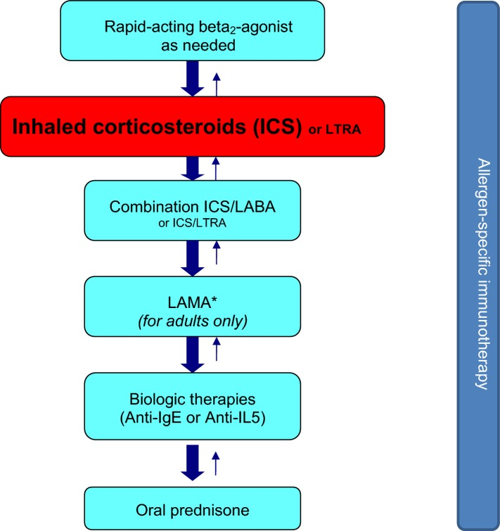
Asthma Treatment
Allergy Asthma Clin Immunol. 2018; 14(Suppl 2): 50.
Notes:
Asthma treatment uses a step-wise escalation of medications based on symptom response. This ladder starts at the top and works down--treatment can also be de-escalated if asthma symptoms are stable.

Slide 21
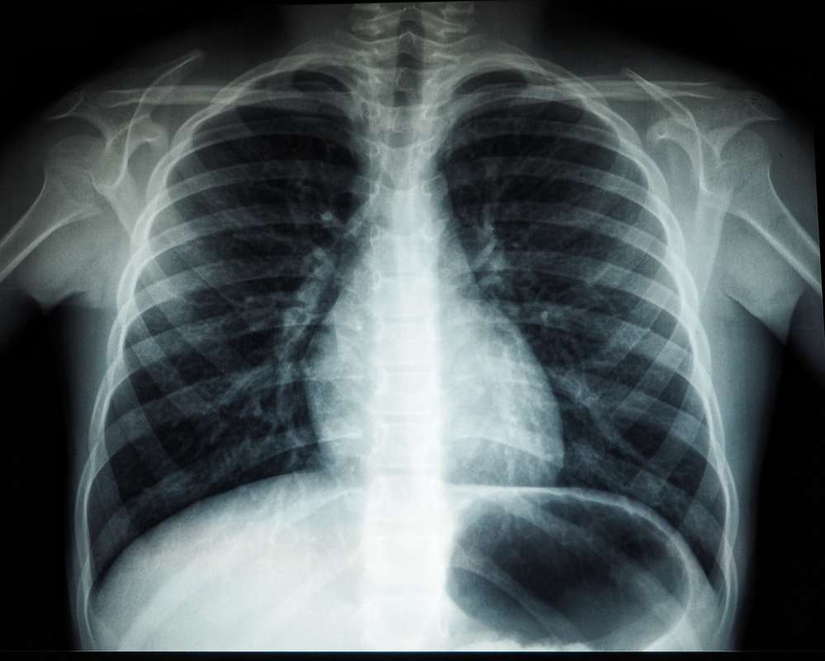
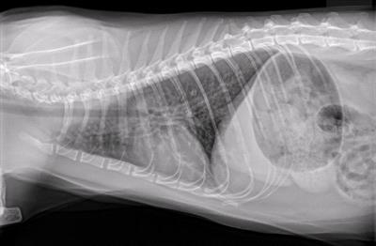
Asthma: Cat vs. Human
Notes:
In veterinary medicine, there are significant radiographic airway changes that are usually not present with human asthma, which implies that feline asthma may actually be better characterized as eosinophilic pneumonia. Human eosinophilic pneumonia is an allergic disease with marked radiographic abnormalities.

Slide 22

If you have allergies, the longer you live with your cats the better your symptoms (and life!) will be!

